Slide 1
Communicating on radiation risk: between science and narrative
Jacques LOCHARD
Director of CEPN
Vice-Chair of ICRP
Second Conference on Science, Technology, and Society (STS)
Perspectives on Nuclear Science, Radiation, and Human Health:
The View from Asia
10-11 November 2015
Nagasaki, Japan
This presentation has neither been approved nor endorsed by ICRP

Slide 2
Content
Radiation risk and its management
Some lessons from Chernobyl and Fukushima
Concluding remarks
2

Slide 3
The three pillars of the system of radiological protection
Science
Ethical and social values
The system
of radiological protection
Experience
3

Slide 4
The scientific basis of the system of radiological protection
Pathology
Epidemiology
Radiobiology
Threshold doses ¹
Dose-risk coefficient ²
System of
radiological
protection
Uncertainties and value judgements
Anatomy
Physiology
Metrology
Doses
¹ Deterministic effects ² Stochastic effects
4

Slide 5
Ethical values
  The principles of radiological protection system are aiming at :
      do more good than arm – Beneficence/non maleficence
      keep exposures as low as reasonably achievable – Prudence
      seek for fair distribution of exposures and do not exceed tolerable levels of exposure - Justice
      treat people with respect – Dignity
  These core values are implemented in practice through the procedural values of accountability, transparency and inclusiveness
  Altogether these ethical values are the constituents of reasonableness and tolerableness, which allow radiation protection professionals to act wisely taking into account of the prevailing circumstances
5

Slide 6
More a century of experience : a brief glimpse
Discovery of X-rays in November 1895
Discovery of radium in February 1896
Early use of X-ray and radium in medicine
Development of the radium industry (the radium dial workers)
Hiroshima and Nagasaki
Operation of nuclear installations
Chernobyl and Fukushima
Modern medical imaging
Management of natural exposures (radon, cosmic radiation, NORM)
6

Slide 7
Why communication about radiation risk
is a challenge?
Apart from radiation protection professionals experts very few people are informed about the risk of radiation and the principles to manage it
No direct sensorial relationship with radiation. Everything passes through language, hence the importance of trust in the word of the other
Professionals and experts tend to use scientific jargon. As a consequence there is very few words in the common language
The recurring debate on the effects of low levels of radiation and issues surrounding nuclear power maintains confusion in the minds of people
The confiscation during decades of expertise of these debates after the second world war left the vast majority of people speechless
The mark of Hiroshima and Nagasaki, and also that of the Cold War are extremely present in the collective consciousness
7

Slide 8
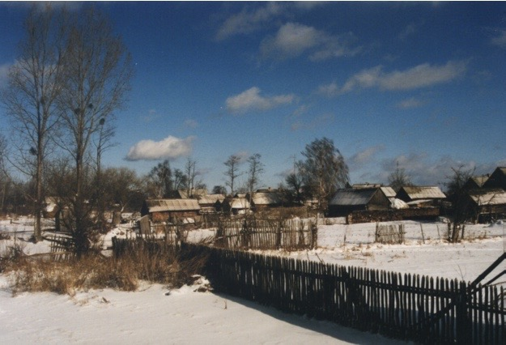
Olmany, Belarus, 1996
8

Slide 9
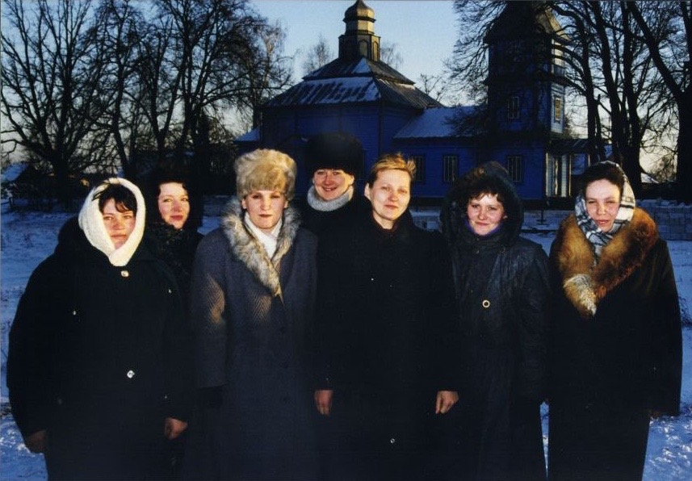
9

Slide 10
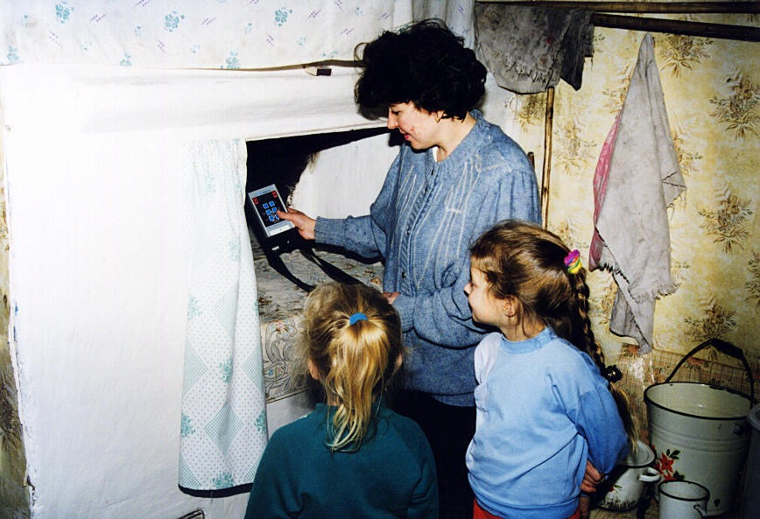
10

Slide 11
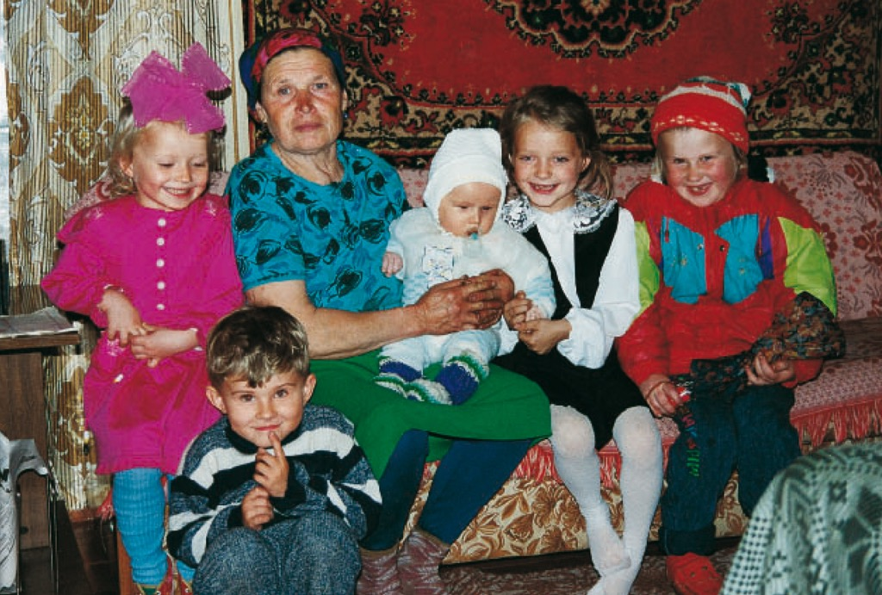
11

Slide 12
What I learned in Belarus?
To listen to the questions and concerns of people
To learn from the people the local situation (co-expertise)
    To ask questions to understand the local situation rather than deliver knowledge
To visit people regularly to establish trust
To not focus on the risk but on the causes of the exposure
To give people the means to make measurements themselves or to be involved in the measurements i.e. to look for the causes of the risk
That it is possible to develop a practical radiation protection culture
To trust the capacity of local stakeholders to implement the procedures to protect themselves (self-help protection)
To use narratives to facilitate the transfer of experience
…
To work with people not for people
12

Slide 13
About narrative
A narrative is any type of discourse or writing that tells a story
It can be a fiction or a nonfiction i.e. a true story with real people and event .
As professionals we have to develop nonfiction narratives
The key component of a narrative are the characters, the setting, the plot/fabric and the narrator
The narrator can either share his/her personal experience (first-person narration) or tell a story in which he was not part of the plot (third-person narration).
In post-accident situation first person narration is very effective to establish trust and to transfer experience
13

Slide 14
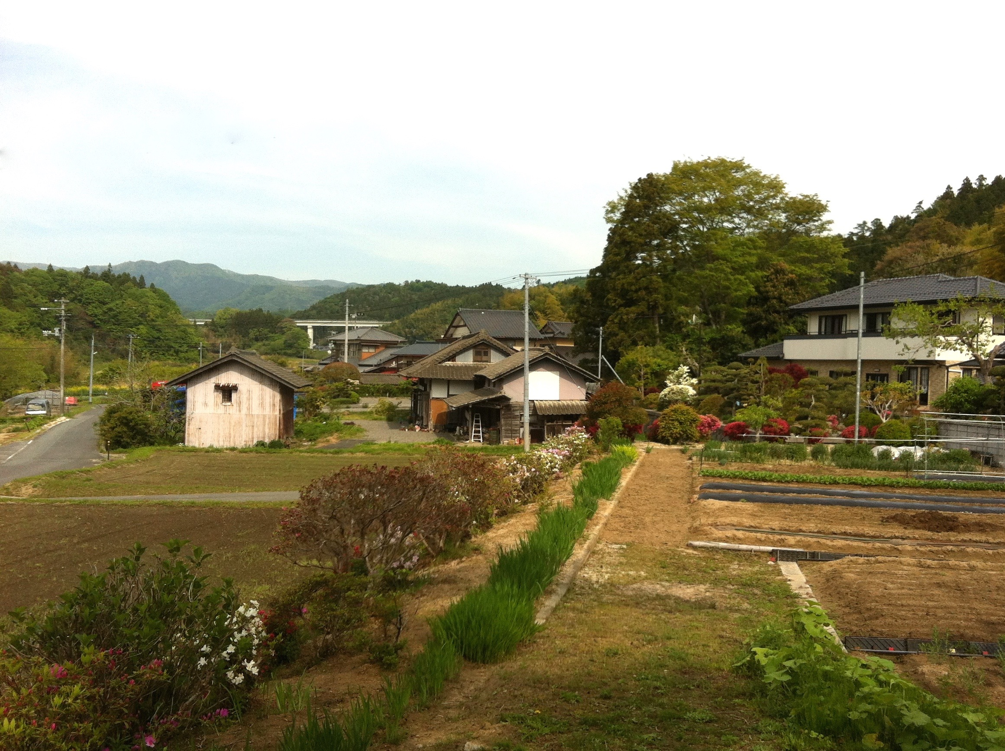
Suetsugi, Japan, 2012
14

Slide 15
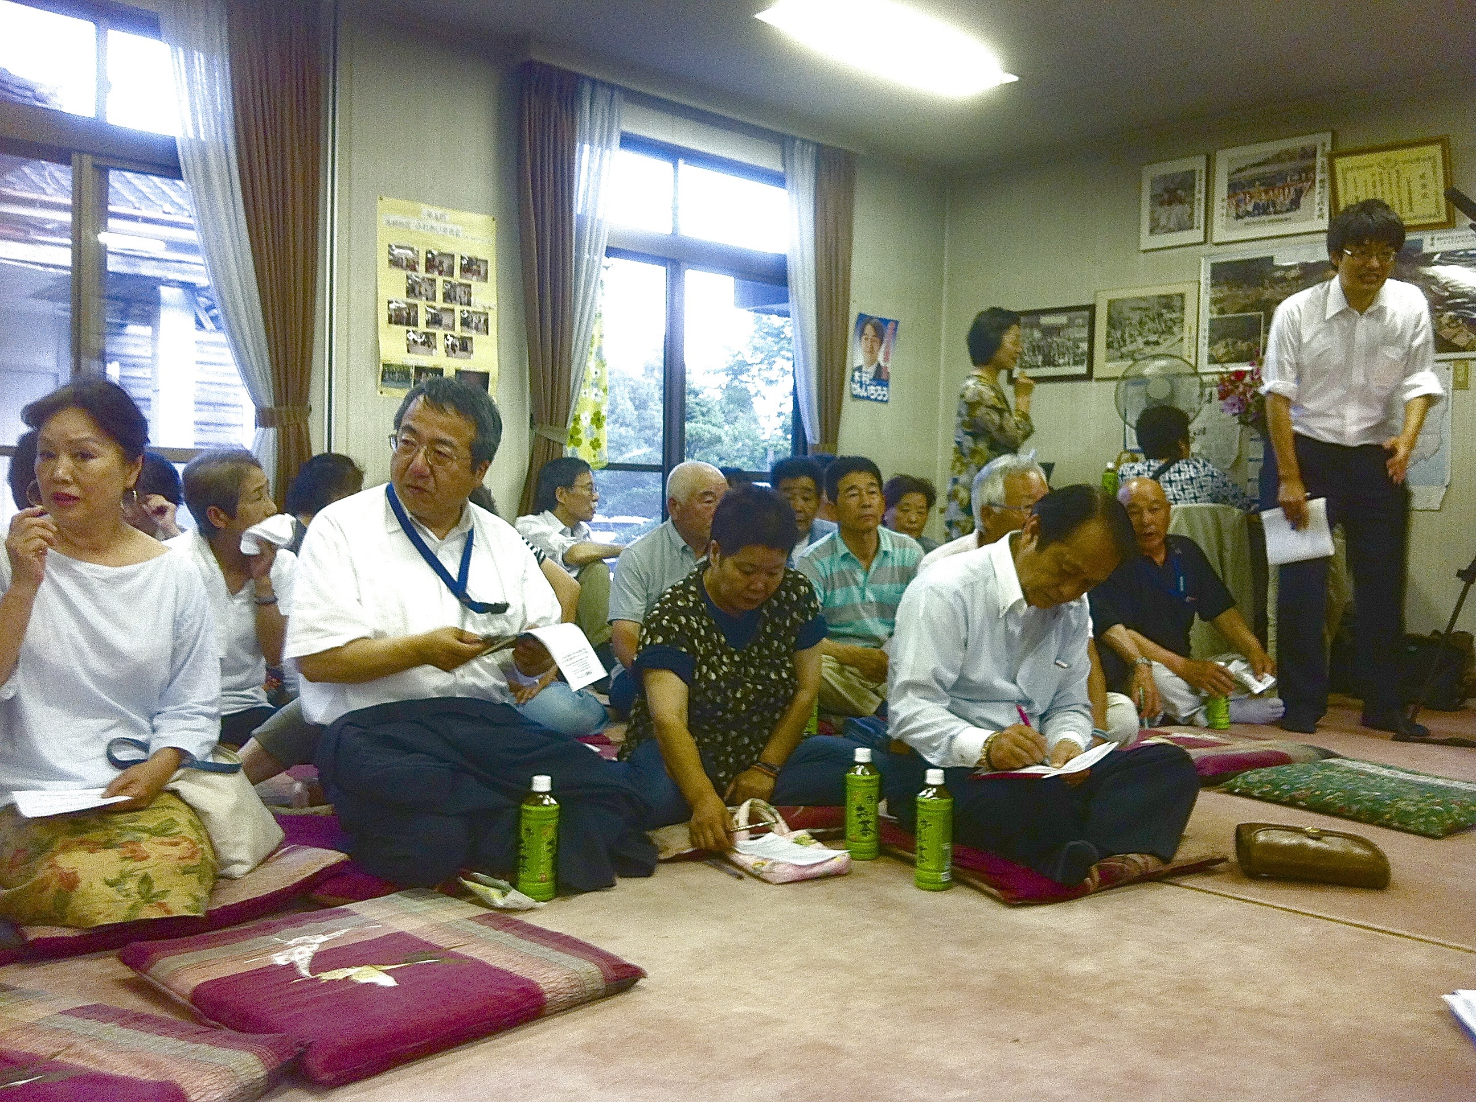
15

Slide 16
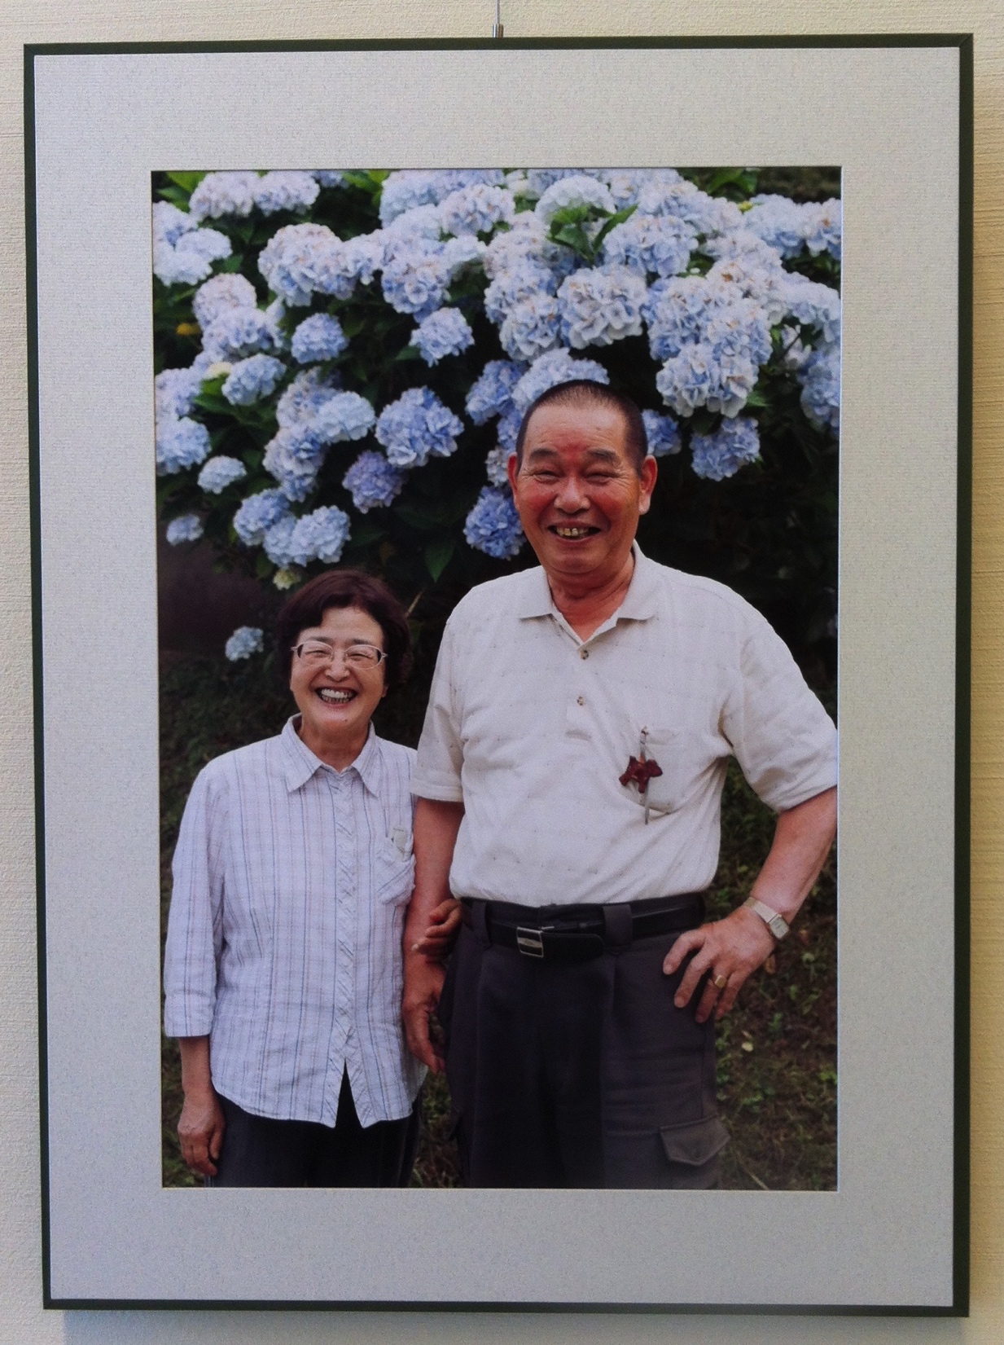
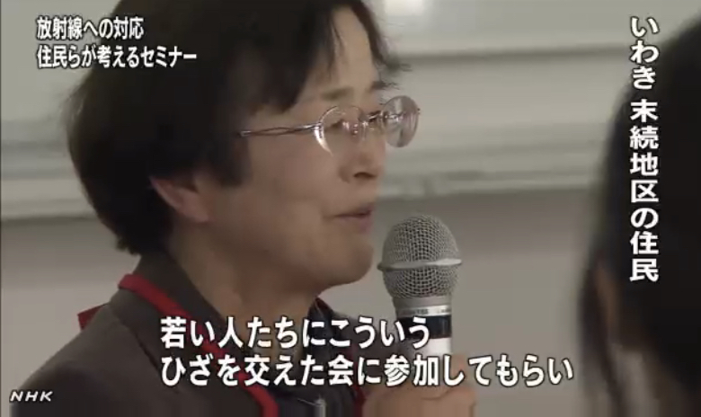
16

Slide 17
The challenge
What happened in Suetsugi shows that the essence of the Belarusian experience is transferable (Despite the cultural, technological and socio-economic, human reactions are quite identical)
Does this particular experience of Chernobyl and Fukushima is transposable to everyday activities in medicine, industry,…?
Is it possible to develop a practical radiological culture, in a normal situation?
On what basis to rely for developing this narrative?
17

Slide 18
And man became transparent...
18

Slide 19
19

Slide 20
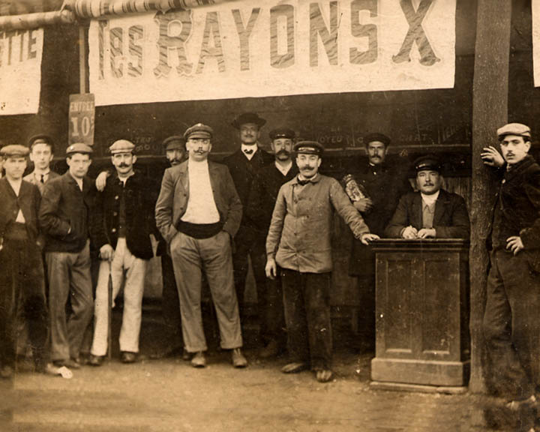
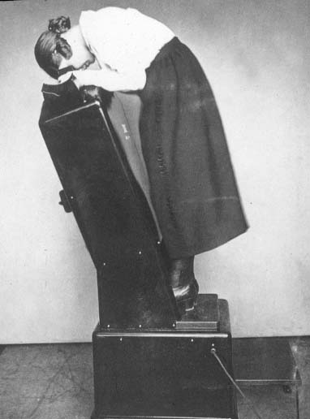
20

Slide 21
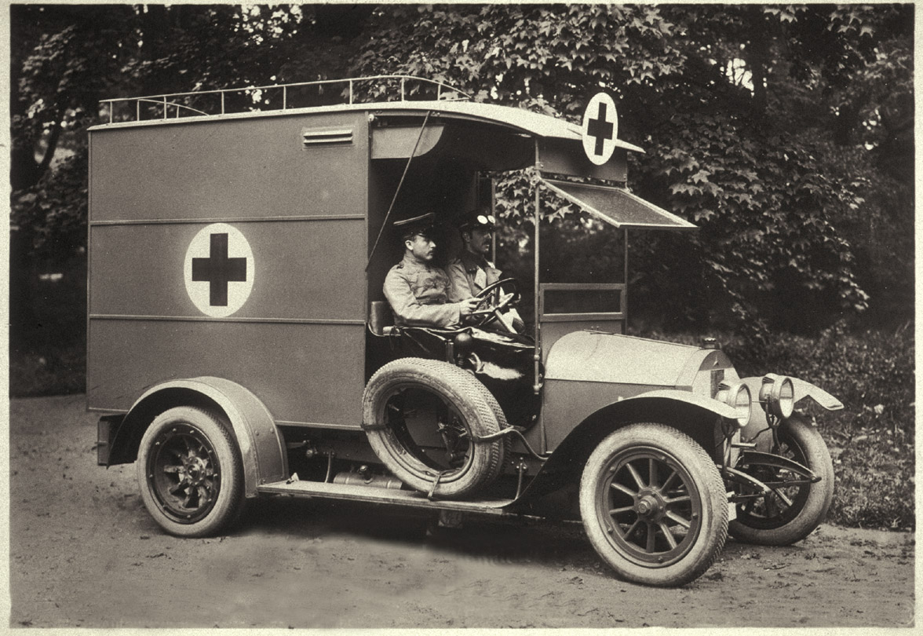
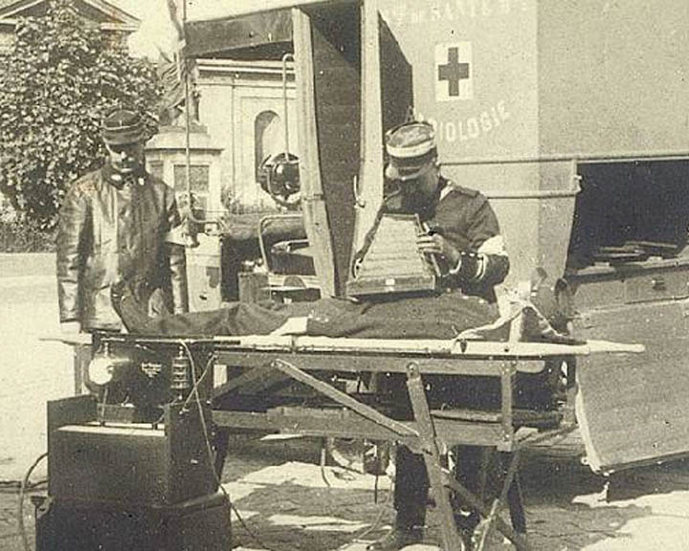
21

Slide 22
22

Slide 23
Other narratives about radiation and radiological protection
The radium saga
The radium girls history
The discovery of fission
The hidden history of the atomic fallout
The Lucky Dragon and Godzilla
The Hibakusha stories
The rehabilitation of living conditions in the affected territories of Belarus after Chernobyl
The resistance of the Sami people in Norway after Chernobyl
The fight of the Cumbrian sheep farmers in Britain after Chernobyl
….
23

Slide 24
Concluding remarks (1)
The system of radiological protection is based on well established scientific evidences although some inevitable uncertainties remains, on universally shared ethical values, and on more than a century of experience
However apart from scientists, experts and professionals, citizens are rarely informed about radiation and even less about the radiological protection system
The relationship of our contemporaries to radioactivity remains largely dominated by the print of Hiroshima and Nagasaki and the uncertainty about the effects of low doses which feeds since decades an on-going scientific and social controversy on the effects of radiation
Despite considerable efforts risk communication had globally a limited impact on the gap of perception between experienced professionals and non informed people
24

Slide 25
Concluding remarks (2)
The lessons learned with stakeholders in Chernobyl and Fukushima tell us that it is perhaps possible to develop a narrative on X-rays, radioactivity and radiation protection to foster the development of a practical radiation protection culture among citizens in apart from exceptional circumstances such as post-accident situations
Such a narrative should definitely rely on history: the great history of the twentieth century and also the history of the development of the uses of radiation and that of the associated radiation protection
It should therefore incorporate stories about the evolution of the scientific knowledge and ethical values ​​that shaped the radiation protection system without forgetting the experience of the professionals and people affected by radiation
25
Notes:
Considerations about the risk to future generations…. « Can we leave to
the future generations the problem of somehow adjusting themselves to
an environment of higher radiation levels? »
The benefit of radiation increase life expectancy by also senility….

Slide 26
Towards a radiation risk culture ?
26

Slide 27

www.ICRP.org
www.icrp.org

