Slide 1
The Updating of ICRP Publication 111 in Light of the Fukushima Experience Feedback
Jacques LOCHARD
Vice-chair of ICRP
Director of CEPN – France
15th International Congress of Radiation Research
Kyoto, Japan
28 May 2015
This presentation has neither been approved nor endorsed by ICRP

Slide 2
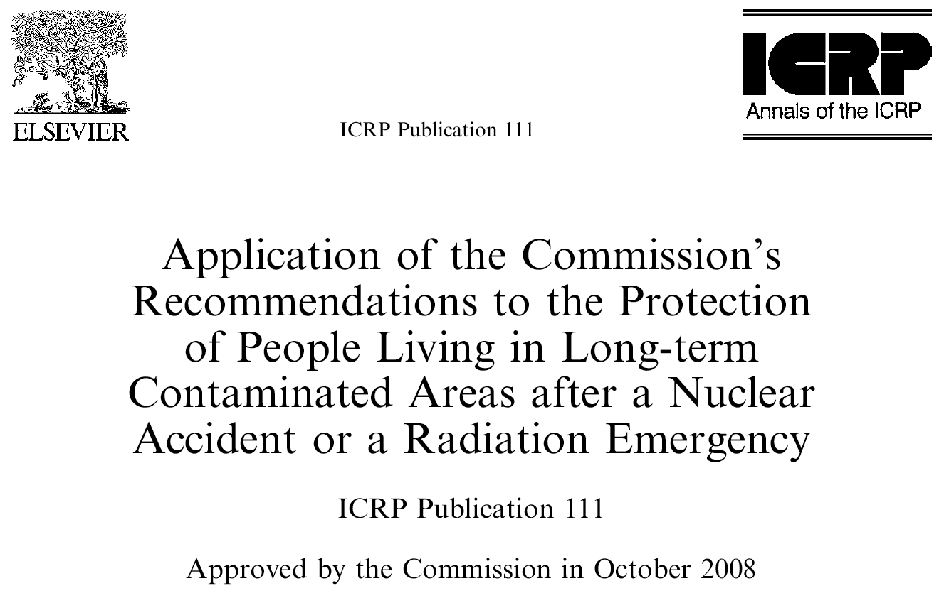
2
Notes:
08/06/15
2

Slide 3
Introductory remarks
The first comprehensive ICRP Recommendations dealing with long-term recovery after a nuclear accident
Previous ICRP Publications were confined to short and medium-term actions but not addressing long-term recovery
Published in 2009 after a long process of 10 years maturation because of the preparation of Publication 103
3

Slide 4
Background of ICRP Publication 111
Based on the Chernobyl experience in Belarus but also of the Cumbria sheep farmers in UK and the Sami reindeer herders in Norway affected by the fallout of Chernobyl
Taking into account the conclusions of the International symposium on the restoration of environments with radioactive residues held in Arlington, USA, November 1999, which emphasized:
  the role of involving stakeholders
  the difficulty to apply the” intervention approach” from ICRP 60
  the wish of the public to be protected with the same level of protection as in ‘normal’ situations
4

Slide 5
Key lessons from Chernobyl
Living in a contaminated environment is a complex situation generating a lot of concerns among the affected population
Exposures are driven by individual behaviours and the socio-economic situation
To be effective protection strategies should include actions implemented by authorities at the national and local levels and by the affected population itself = self help protection actions
This is the responsibility of authorities to establish programmes for continuous radiation monitoring, health surveillance and the information and education of people
5

Slide 6
The recommendations of Publication 111 in short
In line with the ICRP 103 principles and recommendations
Living in contaminated areas is an existing exposure situation
The protection strategy must be justified i.e. doing more good than harm
  Exposures must be optimised with a reference level selected in the lower part of the 1-20 mSv/y band with the long-term objective of keeping residual individual doses from the accident in the range or below 1 mSv/year
Authorities must ensure radiation monitoring, health surveillance and the management of contaminated foodstuffs and commodities
Involving all stakeholders is essential
6

Slide 7
Permanent relocation and return from evacuation
The Commission does not recommend any particular radiation protection criterion. If any is selected, it must be consistent with the guidance concerning the management for existing exposure situations
The decision must be taken by the authorities on a case by case basis taking into account the prevailing circumstances i.e. :
    The residual level of exposure in the affected places and its expected evolution given the remediation actions
    The ability to protect correctly the population and to maintain decent and sustainable societal and economic living conditions in the affected areas
  Individuals have a basic right to decide whether to leave the place or to stay. Difficult to answer this dilemma solely on the basis of radiation protection considerations
7

Slide 8
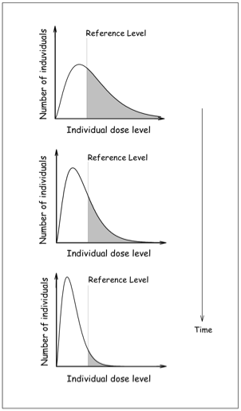
The optimisation process in Publication 111
An on going evaluation of the exposure situation of people to identify where, when and how they are exposed in order to reduce exposure ALARA
The use of a reference level for prioritizing protective actions implemented by national and local authorities and by the affected inhabitants = self-help protection
Fig. Evolution of the distribution of individual doses with time as a result of the optimization process
8

Slide 9
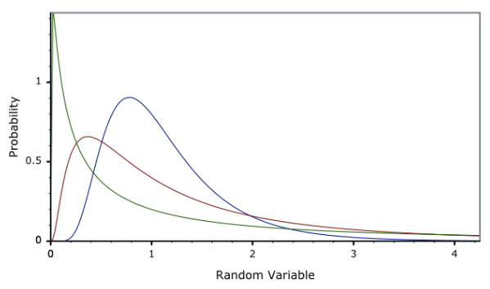
  The role of reference levels
    To reduce inequity in the distribution of individual exposures
Optimisation
Number of individuals
Reference
level
Level of exposure
9
Notes:
Considerations about the risk to future generations…. « Can we leave to
the future generations the problem of somehow adjusting themselves to
an environment of higher radiation levels? »
The benefit of radiation increase life expectancy by also senility….

Slide 10
  ICRP and Fukushima
Soon after the Fukushima accident ICRP took a series of initiatives:
  In March an open letter of the ICRP Chair to express sympathy to the Japanese population and offer a free access to Publication 111 on the ICRP web site
  Creation in April of Task Group 84 on the initial lessons learned from the accident vis-à-vis the ICRP system of radiological protection
Visit of Japanese ICRP members in Belarus late September 2011
Launching in November 2011 of the ICRP Dialogue Initiative in Fukushima with Japanese, Belarus and Norwegian stakeholders to find ways to respond to the challenges of the long-term recovery in the affected areas
Creation in September 2013 of Task Group 93 of ICRP Committee 4 to update Publications 109 and 111 under the chairmanship of Michiaki Kai and Toshimitsu Homma from Japan
10

Slide 11
  The Fukushima recovery phase
The recovery phase started early 2012:
  December 2011: announcement of the stabilisation of the reactors
  January 2012: launching of the decontamination programme
  April 2012: new regulation on contaminated food products and rearrangement of the restricted areas
  From this period the situation can be considered as an existing exposure situation
The Fukushima experience supports the position of Pub. 111, which states that the shift from the emergency to the existing exposure situation is a decision of public authorities
A key element for this shift is the characterization of the radiological situation in the affected areas to decide about their future. This characterization was not at all emphasized in Pub. 111
11

Slide 12
  From emergency to existing exposure situation
Emergency Exposure Situation
Protection actions to reduce and maintain exposure ALARA are driven by urgency
Reference level in the 20-100 mSv/year range
Characterization of the radiological situation
Setting-up radiation monitoring, health surveillance and foodstuffs management
Existing Exposure Situation
Protection actions to reduce and maintain exposure ALARA and to improve quality of life
Reference level in the lower part of the 1-20 mSv/year range with long term objective of less than 1 mSv/year
Radiation protection culture
Self-help protection
Decision by
authorities
12

Slide 13
  Some lessons from the ICRP Dialogue Initiative in Fukushima
The human consequences of the accident are massive and will be lasting
Expertise and support must be at the service of local citizens
Individual monitoring (internal and external) and self-measurement of land and food products are essential, and require outside support
Radiation protection culture is at least as important as remediation to improve safety and a feeling of security
Local communities must be engaged in developing improvement projects and in assessing progress
Success depends on the combined action of authorities and self-help actions implemented by the affected population
13

Slide 14
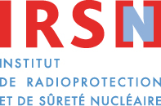
  The human dimension of post-accident situations
Serious disturbances of daily life
Disintegration of family and social relationship
Distancing from the familiar environment
Loss of trust in authorities and experts
Strong concerns about potential health effects particularly for children
General feeling of helplessness and abandonment
General feeling of discrimination and exclusion reinforced by the look and attitude of outsiders
Loss of control and autonomy of people and apprehension of their future
14

Slide 15
  The role of expertise in the post-accident situation
The Fukushima experience has confirmed the importance of the co-expertise process i.e:
    Establishing places for dialogue so that experts can hear people’s questions and concerns and can talk with them about their expectations
    Jointly assess the situation of local people and communities
    Implementing local projects to address the problems identified at the individual and the community levels with the support of institutional experts, local authorities and professional community workers particularly medical professionals and teachers
15
Notes:
08/06/15
15

Slide 16
  The development of the practical radiological protection culture
The Fukushima experience has also confirmed that the co-expertise process is very effective to develop a practical radiological protection culture among the affected people, gradually allowing everyone:
    To interpret results of measurements: ambient levels, external and internal doses, contamination of products
    To build her/his own benchmarks against radioactivity in day-to-day life
    To make her/his own decisions and protect her/himself and loved ones = self-help protection
In this approach, access to individual measurements by the people with suitable devices is critical
16
Notes:
08/06/15
16

Slide 17
  The stakeholder engagement process
Citizens are informed, and supported by experts
Individuals and the community they belong take effective actions to improve their living conditions
Co-expertise
Radiological Protection Culture
Self Help Protection
17

Slide 18
  Ethical considerations
To involve stakeholders in the post-accident management raises questions such as:
  Is this a strategy to let individuals alone to face the post-accident situation?
  Is there not a risk of manipulation inasmuch as being involved, individuals would be forced to accept the situation?
  Does the involvement of stakeholders is not a risk of leading to the disengagement of the responsibility of authorities and experts?
Some ethical principles underlying Publication 111
  Commitment of authorities and experts to be at service of improving the protection and living conditions for the population
  Refusal to take decision for the people about their future (respect of the autonomy and freedom of individuals)
18
Notes:
18

Slide 19
  Concluding remarks
The experience of Fukushima does not fundamentally question the approach of Publication 111 but calls for some adjustments
The role of the characterization of the radiological situation should be put forward
Considerations about decontamination and the management of the associated wastes as well as the protection of recovery workers should be introduced
The role of reference levels and their use in the recovery phase should be clarified
More emphasis should be given on the human dimension as well as the ethical aspects of post-accident situations
Finally, the role of experts and the importance of engaging local stakeholders in the management of the radiological situation to rehabilitate their living conditions and restore their dignity should be strongly reaffirmed
19

Slide 20

www.icrp.org
www.icrp.org

