Slide 1
Some Considerations about the Ethical and Social Dimensions of the Radiological Protection System
Jacques LOCHARD
Vice Chair of ICRP
Director of CEPN - France
Master and Doctorate Program "Nuclear Science and Technology"
Technical University of Madrid (UPM)
4 February 2015, Madrid, Spain
This presentation has neither been approved nor endorsed by ICRP

Slide 2
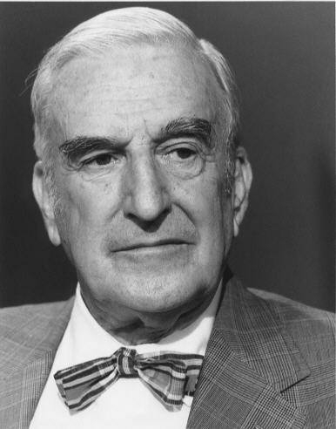
Ethics in radiological protection
- A long tradition -
“Radiation protection is not
only a matter for science. It
is a problem of philosophy,
and morality, and the utmost
wisdom.”
The Philosophy Underlying
Radiation Protection
Am. J. Roent. Vol. 77, N° 5,
914-919, 1957
From address on 7 Nov. 1956
Lauriston S. Taylor (1902 – 2004)
Chair of ICRP from 1937 to 1962
2

Slide 3
  Wisdom
  A basic definition of wisdom is the quality of having experience, knowledge, and good judgement (Oxford dictionary)
  In its popular sense, wisdom is attributed to a person who takes reasonable decisions and act accordingly
  As a virtue, wisdom is the disposition to behave and act with the highest degree of adequacy under any given circumstances often in line with an ethics combining self-awareness and that of others, temperance, prudence, sincerity and discernment based on reasoned knowledge
3

Slide 4
A brief historical perspective about the evolution of the
ICRP system of radiological protection (1)
The system of radiological protection developed gradually during the XXth century integrating advances in knowledge about the effects of radiation, the evolution of the ethical and social values as well as the feedback experience from its practical implementation
Until the Second World War the Commission was only dealing with the protection of medical staffs
After the war the focus was on nuclear energy and radiological protection developed to protect workers inside nuclear installations and the public outside. This resulted in a coherent and effective regime of radiological protection based on solid concepts and principles (ICRP 60)
4
Notes:
Considerations about the risk to future generations…. « Can we leave to
the future generations the problem of somehow adjusting themselves to
an environment of higher radiation levels? »
The benefit of radiation increase life expectancy by also senility….

Slide 5
A brief historical perspective about the evolution of the
ICRP system of radiological protection (2)
The Chernobyl nuclear accident followed by the raising concerns on exposure situations inherited from the past in the nineties, then the threat of “malevolent events” following the September 11 attacks profoundly questioned the ICRP 60 recommendations
Although not explicit, this questioning has played an important role in the development of the new recommendations in Publication 103 published in 2007
The system of Publication 103 has often been presented as a simple update of the previous system (ICRP 60), but in fact it represents a major evolution
5
Notes:
Considerations about the risk to future generations…. « Can we leave to
the future generations the problem of somehow adjusting themselves to
an environment of higher radiation levels? »
The benefit of radiation increase life expectancy by also senility….

Slide 6
A brief historical perspective about the evolution of the
ICRP system of radiological protection (3)
  The three main evolutions of the system of protection in Pub. 103 are:
    The introduction of 3 types of exposure situations with the generalization of the optimisation principle in connection with individual dose restrictions to all controllable exposure situations
    The introduction for the first time in general recommendations of “the need to account for the views and concerns of stakeholders when optimising protection”
    The protection of the environment (fauna and flora)
6
Notes:
Considerations about the risk to future generations…. « Can we leave to
the future generations the problem of somehow adjusting themselves to
an environment of higher radiation levels? »
The benefit of radiation increase life expectancy by also senility….

Slide 7
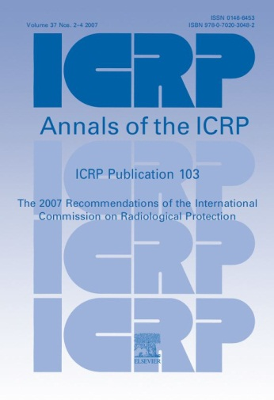
The three pillars of the
ICRP system of radiological protection
Science
Ethical and social values
ICRP
system of radiological protection
Experience
Publication 103
7

Slide 8
  The aims of the
  ICRP system of radiological protection
      “… to contribute to an appropriate level of protection against the detrimental effects of ionising radiation exposure without unduly limiting the benefits associated with the use of radiation.” ICRP 103, § 26
      “… to manage and control exposures to ionizing radiation so that deterministic effects are prevented, and the risks of stochastic effects are reduced to the extent reasonably achievable.” ICRP 103, § 29
      Estimating and comparing benefits and risk of different options before acting is one of the most common ethical dilemmas in daily life
8

Slide 9
The scientific basis of the system of radiological protection
Epidemiology
Radiobiology
Threshold doses
Radiation detriment
System of
radiological
protection
Uncertainties and value judgements
Anatomy
Physiology
Metrology
Effective dose
9

Slide 10
  Uncertainties and prudence
« It is prudent to take uncertainties in the current estimates of thresholds for deterministic effects into account… Consequently, annual doses rising towards 100 mSv will almost always justify the introduction of protective actions ». ICRP 103, § 35
« At radiation doses below around 100 mSv in a year, the increase in the incidence of stochastic effects is assumed by the Commission to occur with a small probability and in proportion to the increase in radiation dose… The Commission considers that the LNT model remains a prudent basis for radiological protection at low doses and low dose rates. » ICRP 103, § 36
«There continues to be no direct evidence that exposure of parents to radiation leads to excess heritable disease in offspring. However, the Commission judges that there is compelling evidence that radiation causes heritable effects in experimental animals. Therefore, the Commission prudently continues to include the risk of heritable effects in its system of radiological protection.» ICRP 103, § 74
10

Slide 11
  About prudence
  Prudence is one of the fundamental ethical values that structures the system. It allows to take into account the uncertainties of the radiation risk, particularly at low doses of radiation, and to act judiciously and reasonably
  Prudence concerns the contingent, that is what can happen or not happen, which is occasional, incidental or uncertain. Prudence guides the actions of humans towards what is useful and good for them. Prudence varies according to individuals and circumstances
  Prudence implies a duty of vigilance regarding the effects of radiation: the requirement of radiation and health monitoring of exposed populations and the duty to relentlessly pursue research in the fields of epidemiology and radiobiology to try to reduce uncertainty
11

Slide 12
  The implications of prudence for stochastic effects
  Risk taking is justified only if there is a benefit in return
  ➔ Justification of decisions
  Once an activity is justified:
    How far to reduce the risk?
    How not to jeopardize the activities?
    What rationale/criteria to use to base decisions on the right level of protection?
    ➔ The quest for reasonableness
  Maintaining exposures below a threshold is not a guarantee of no risk
  ➔ Restricting individual exposure is an issue of
  tolerability of risk
12

Slide 13
The basic components of the ICRP system of radiological protection for humans
Exposure situations
Categories
of exposure
Principles
of protection
Dose criteria
Requisites
13

Slide 14
  Exposure situations
Existing exposure situations: exposures resulting from natural and man-made sources that already exist when decisions to control them are taken. Characterization of exposures is a prerequisite to their control
Planned exposure situations: exposures resulting from the deliberate introduction and operation of sources used for their radioactive and radiation properties. Exposures can be anticipated and fully controlled but may be significantly higher than expected in case of incidents and accidents.
Emergency exposure situations: when exposures result from the loss of control of a source or from any unexpected situation. These situations require urgent and timely actions in order to mitigate exposures
14
Notes:
09/02/15
14

Slide 15
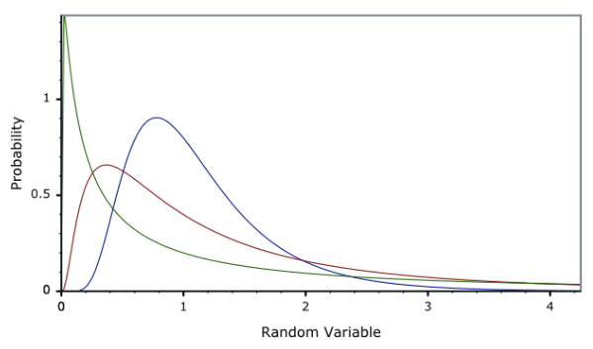
Individual dose distributions associated with exposure situations
Number of individuals
Level of exposure
15
Notes:
09/02/15
15

Slide 16
  The categories of exposure
  Medical exposure: radiation exposures received by patients in the course of diagnostic, interventional, and therapeutic procedures
  Occupational exposure: radiation exposures incurred at work as a result of exposure situations that can reasonably be regarded as being the responsibility of the operating management
  Public exposure: encompasses all radiation exposures of the public other than occupational and medical exposure
  Although individuals may fall into the 3 categories respectively as workers, patients or members of the public, ICRP considers the management of each category separately
16
Notes:
09/02/15
16

Slide 17
  The principles of radiological protection
  The principle of justiﬁcation: Any decision that alters the radiation exposure situation should do more good than harm
    ➔ This refers to the ethical value of beneficence/non-maleficence
  The principle of optimisation of protection: All exposures should be kept as low as reasonably achievable
  ➔ From an ethical point of view, this principle refers to the virtue of prudence
  The principle of limitation of individual exposure: All individual exposures should not exceed the dose criteria recommended by the Commission
  ➔ This refers to the ethical values of justice and equity
17
Notes:
09/02/15
17

Slide 18
  The quest for reasonableness
  Recognizing that there may be no threshold for stochastic effects and taking into account the irreversibility of these effects, the Commission adopts a prudent attitude and recommends to reduce exposures to the lowest possible level (ICRP-1950)
  The reduction of risk must be compared with the effort to achieve it. Recommendation to keep exposures as low as readily achievable, economic and social considerations being taken into account (ICRP 9 -1965)
  The adverb ‘readily’ is replaced by ‘reasonably’ (ICRP 22 -1973). Attempt to found the reasonable on economic theory with the introduction of the cost-benefit model as an attempt
  Adoption of a more pragmatic approach with the optimisation process (ICRP 55 -1988) taking into account equity (ICRP 60 – 1990) and the involvement of stakeholders (ICRP 103 - 2007)
18

Slide 19
Dose criteria
  For preventing deterministic effects
    Dose limits to organs
  For mitigating the risk of stochastic effects to tolerable levels
  Source related restrictions associated with the optimisation principle:
    Reference levels for existing and emergency exposure situations
    Dose constraints for planned exposure situations
  Individual related restrictions:
    Dose limits applying only to planned situations other than medical exposure
19
Notes:
09/02/15
19

Slide 20
  Individual dose restrictions
For the selection of an appropriate value for the dose restrictions one should consider the relevant exposure situation in terms of the nature of the exposure, the benefits from the exposure situation to individuals and society,…, and the practicability of reducing or preventing the exposures (ICRP 103, § 242)
“At doses higher than 100 mSv, there is an increased likelihood of deterministic effects and a significant risk of cancer. For this reason the Commission considers that the maximum value for a reference value is 100 mSv incurred either acutely or in a year.” (ICRP 103, § 236)
This statement needs some clarification about how to interpret the “acutely or in a year” in the context of emergency exposure situations
20
Notes:
Considerations about the risk to future generations…. « Can we leave to
the future generations the problem of somehow adjusting themselves to
an environment of higher radiation levels? »
The benefit of radiation increase life expectancy by also senility….

Slide 21
  Individual dose restrictions and optimisation
Dose constraints in planned exposure situations and reference levels in emergency and existing exposure situations allow to restrict inequity in individual dose distributions
Optimisation
Number of individuals
Individual
dose restriction
Level of exposure
21
Notes:
Considerations about the risk to future generations…. « Can we leave to
the future generations the problem of somehow adjusting themselves to
an environment of higher radiation levels? »
The benefit of radiation increase life expectancy by also senility….

Slide 22
The quest for tolerability
Publication 26 (1977) : the risk associated with dose limits compared with safe occupation for occupational exposures and risk regularly accepted in everyday life (e.g. public transport) for public exposures
Publication 60 (1990): introduction of the tolerability of risk model: difference between unacceptable, tolerable and acceptable levels of risk. Use of a multi-criteria approach for the occupational dose limit and reference to the natural background for the public dose limit
It is interesting to note that there are no considerations about the tolerability of risk in Publication 103
22

Slide 23
The requisites
  The basic requisites that apply to all exposure situations and categories of exposure
    Evaluation of exposure
    Information of exposed individuals
    Involvement of stakeholders (Introduced in Pub. 103)
  These basic requisites are declined differently depending of the exposure situation and the category of exposure e.g. informed consent in the medical field, training and individual monitoring of occupationally exposed workers,…
23
Notes:
09/02/15
23

Slide 24
The vision of a pioneer
“Aside from our experienced scientists, trained in radiation protection, where do we look further for our supply of wisdom? Personally, I feel strongly that we must turn to the much larger group of citizens generally, most of whom have to be regarded as well-meaning and sincere, but rarely well-informed about the radiation problems that they have to deal with. Nevertheless, collectively or as individuals, they can be of great value … in developing our total radiation protection philosophy.”
Lauriston Taylor, Sievert Lecture, IRPA 5 Congress, Jerusalem, 1980
24
Notes:
Use of the term « cautious procedure »

Slide 25
Stakeholder engagement
Concretely stakeholder engagement in radiation protection emerged in the late 80s and early 90s in the context of the management of exposures in contaminated areas by the Chernobyl accident and contaminated sites by past activities
Why to engage stakeholders?
    To take into account their concerns and expectations as well as the prevailing circumstances of the exposure situations
    To adopt more effective and fairer protection actions
    To diffuse radiation protection culture
    To favour their empowerment and autonomy i.e to promote their dignity
25

Slide 26
  About dignity
  Dignity is an attribute of human condition : idea that something is due to the human being because she/he is human. This means that every individual deserves unconditional respect, whatever her/his age, sex, health, social condition, ethnic origin and religion.
  Personal autonomy is the corollary of human dignity. Idea that individuals have the capacity to act freely and morally.
  Human dignity is not natural: it is a conquest over the inhuman. Dignity is cultural. This is an agreement between a culture and those who share it
  Dignity is enshrined in the Universal Declaration of Human Rights (1948): “All human beings are born free and equal in dignity and rights” (Art. 1)
26

Slide 27
Concluding remarks
Not only the ICRP system of radiological protection is based on well established scientific evidences but also on universally shared ethical values: prudence, beneficence, justice and dignity
The system is globally well structured and coherent with the principle of optimisation being the cornerstone and reasonableness and tolerability the core elements
Apart from scientists, experts and professionals, citizens are rarely informed about radiation and even less about the radiological protection system
Lessons from engaging with stakeholders during the last 2 decades tell us that we, as professionals, must develop a narrative about the ethical and social values embodied into the radiological protection system
27

Slide 28

Thank you
www.icrp.org
www.icrp.org

