Slide 1
The ICRP’s Experience with Long-Term Recovery Efforts: From Chernobyl to Fukushima
Jacques LOCHARD
Vice-Chair, ICRP Main Commission
ICC Special Session on Recovery from
Large Scale Nuclear Contamination – What have we learned?
HPS 2014 meeting
15 July, Baltimore, USA
This presentation has neither been approved nor endorsed by ICRP

Slide 2
Content
Introduction: ICRP Publications and long-term recovery
The Chernobyl experience
ICRP Publication 111
The ICRP Dialogue Initiative in Fukushima
First lessons from Fukushima
Conclusion: the update of Publication 111
2

Slide 3
ICRP and long-term recovery after a nuclear accident
ICRP Pub 40 (1984) on the «Protection of the public in the event of major radiation accidents - Principles for planning» and ICRP, Pub 63 (1993) on «Principles for intervention for protection of the public in a radiological emergency» were confined to short and medium-term actions but not addressing long-term recovery
ICRP Pub 82 (1999) on the «Protection of the public in situations of prolonged radiation exposure» was a generic conceptual approach based on ICRP 60 (intervention levels) with limited practical guidance for managing long-term recovery after a nuclear accident. A key point however was the mention for the first time in an ICRP Publication of the role of stakeholder involvement in the decision making process
The first comprehensive ICRP Recommendations dealing with long-term recovery were those published in Pub 111 (2009) based on the Chernobyl experience in the CIS and Western Europe: «Application of the Commission’s recommendations to the protection of people living in long-term contaminated areas after a nuclear accident»
3

Slide 4
The Chernobyl experience (1)
The problematic of long-term post accident recovery emerged rather soon after the Chernobyl accident in the late 80s
After a long debate a quite similar recovery strategy was adopted in the early 90s in Belarus, Russia and Ukraine based on:
  The relocation of the population if the average annual dose might exceed 5 mSv/year
  The support (compensation) of the population willing to stay in contaminated areas with average annual dose ranging from 1 to 5 mSv/year and of the population willing to relocated in non contaminated areas (with average annual dose less than 1 mSv/year)
  A large programme of “countermeasures” particularly in the agriculture domain
4

Slide 5
The Chernobyl experience (2)
Despite all the efforts of the CIS authorities to implement the adopted strategy the radiological situation gradually worsened, partly due to the economic crisis following the breakdown of the Soviet-Union, but mainly because it failed to take into account the complexity of the situation created by the long lasting contamination
In the mid 90s several surveys showed that :
  Inhabitants of the contaminated territories were helpless in front of the contamination
  There was a general feeling among the population of loss of control on daily life, exclusion and abandonment
  There was also a rising concern about the potential health consequences of staying in the contaminated areas, particularly for children
  The confidence in experts and authorities was almost completely lost
5

Slide 6
The ETHOS Project in Belarus (1996-2001)
A pilot experiment supported by the Belarus authorities and implemented by a team of European experts in 5 villages of Southern Belarus affected by the Chernobyl accident
Aiming at developing a sustainable improvement of the living conditions of the affected population based on the direct involvement of the local stakeholders in their own protection
Developed with groups of teenagers, young mothers, farmers, teachers, health care professionals, foresters,… in the villages
Addressing their key concerns :
  The protection of children
  The radiological quality of foodstuffs
  The regain of the control of the situation as well as decent living conditions
6
Notes:
16/07/14
6

Slide 7
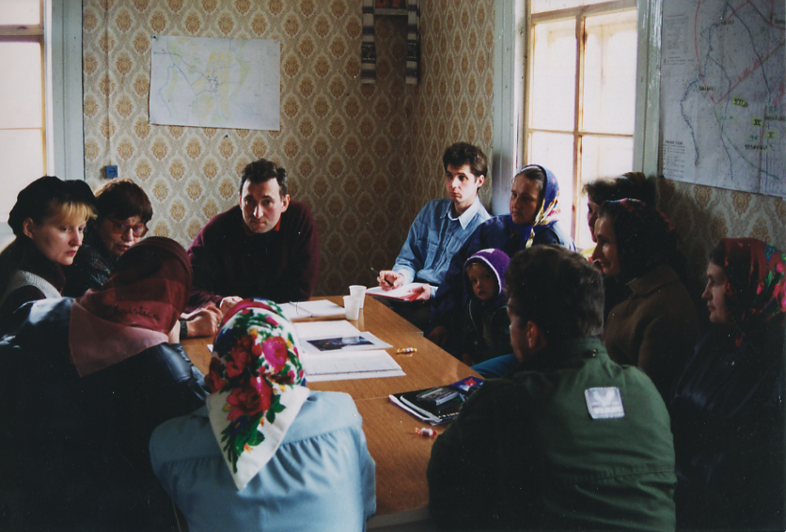
The Ethos Project – Belarus (1996-2001)
Listening to people’s concerns
7

Slide 8
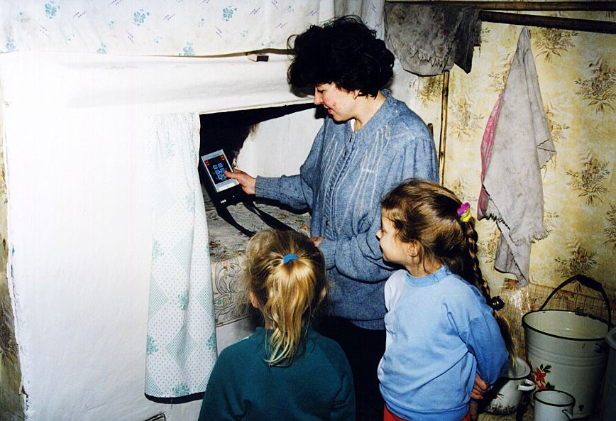
The Ethos Project – Belarus (1996-2001)
Measurements in homes by villagers
8

Slide 9
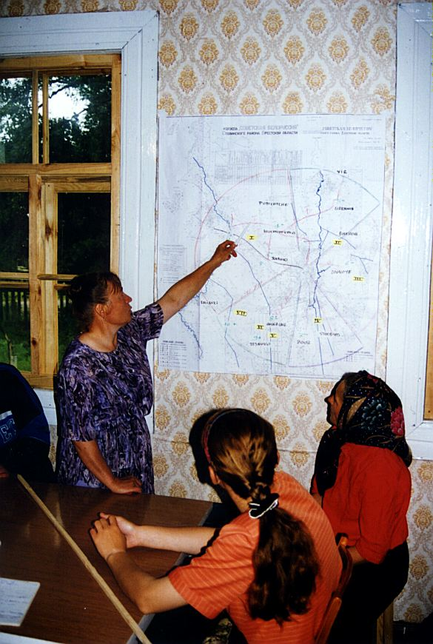
The Ethos Project – Belarus (1996-2001)
Looking for room for manoeuver
9

Slide 10
Lessons from the Ethos Project (1)
Living in a contaminated environment is a complex situation affecting all dimensions of daily life and generating a lot of questions and concerns among the affected population
Exposures are driven by individual behaviours and the socio-economic situation of the affected population
The direct engagement of the population in the day to day management of the situation is feasible and also necessary to break the vicious circle of exclusion and loss of control
This engagement is only possible with the support and cooperation of experts and local professionals who are at the service of the population - Co-expertise process
The co-expertise process is progressively developing a practical radiation protection culture among the population that allows individuals to take charge of their protection and that of their loved ones - Self-help protection
10

Slide 11
Lessons from the Ethos Project (2)
The development of the practical radiation protection culture, which can be defined as the “knowledge and skills enabling each citizen to make choices and behave wisely in a contaminated environment” relies on 3 pillars: radiation monitoring, health surveillance and education at school
It is the responsibility of authorities to establish programmes for continuous radiation monitoring, health surveillance, information of the population to allow the effective engagement of the affected affected people
The pluralism of sources of measurement (public and private; local and national) is important for ensuring confidence of the population in the results
The establishment of places for dialogue is essential for the dissemination of information and the development of a common language between all involved stakeholders
11

Slide 12
ICRP Publication 111 (1)
The result of a long maturation (1999 - 2009)
Based on the experience of the Ethos project in Belarus but also of the Cumbria sheep farmers in UK and the Sami reindeer herders in Norway affected by the fallout of Chernobyl
Taking into account the conclusions of the International symposium on the restoration of environments with radioactive residues held in Arlington, USA, November 1999, which emphasized:
  the role of stakeholders
  the difficulty to apply the “intervention approach” from ICRP 60
  the wish of the public to be protected with the same level of protection as in normal situations
12

Slide 13
Publication 111 (2)
Based on the ICRP 103 principles: existing exposure situation; justification of the protection strategy; optimisation with a reference level to restrict inequity in the individual dose distribution selected in the 1-20 mSv/y band; stakeholder engagement
Practical recommendations:
  Reference level in the lower part of the 1-20 mSv/year band with the long-term objective of keeping residual individual doses from the accident below 1 mSv/year
  Practical radiation protection culture, self-help protection action
  Radiation monitoring and health surveillance
  Management of contamination foodstuffs
  Role of authorities to support the effective engagement of the affected population
13

Slide 14
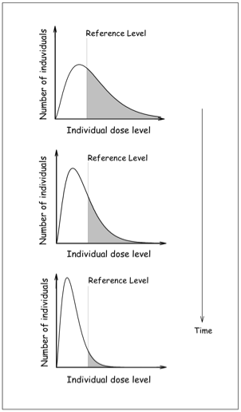
The optimisation process in Publication 111
On going evaluation of the exposure situation to identify where, when and how people are exposed
Use of a reference level to prioritize the protection of individuals with the highest exposure and in parallel to reduce all exposures ALARA
Implementation of the protective actions by national and local authorities and by the affected inhabitants = self-help protection
Fig. Evolution of the distribution of individual doses with time as a result of the optimization process
14

Slide 15
The Fukushima recovery phase
The recovery phase started early 2012:
  December 2011: announcement of the stabilisation of the reactors
  January 2012: launching of the decontamination programme
  April 2012: new regulation on contaminated foodstuff and rearrangement of the restricted areas
  From this period the situation can be considered as an existing exposure situation
It is interesting to note that the Fukushima experience supports the position of Pub. 111, which states that the transition from the emergency to the existing exposure situation is the decision(s) of public authorities
A key element is the characterization of the radiological situation in the affected areas to decide about their future. This characterization is not very well emphasized in Pub. 111
15

Slide 16
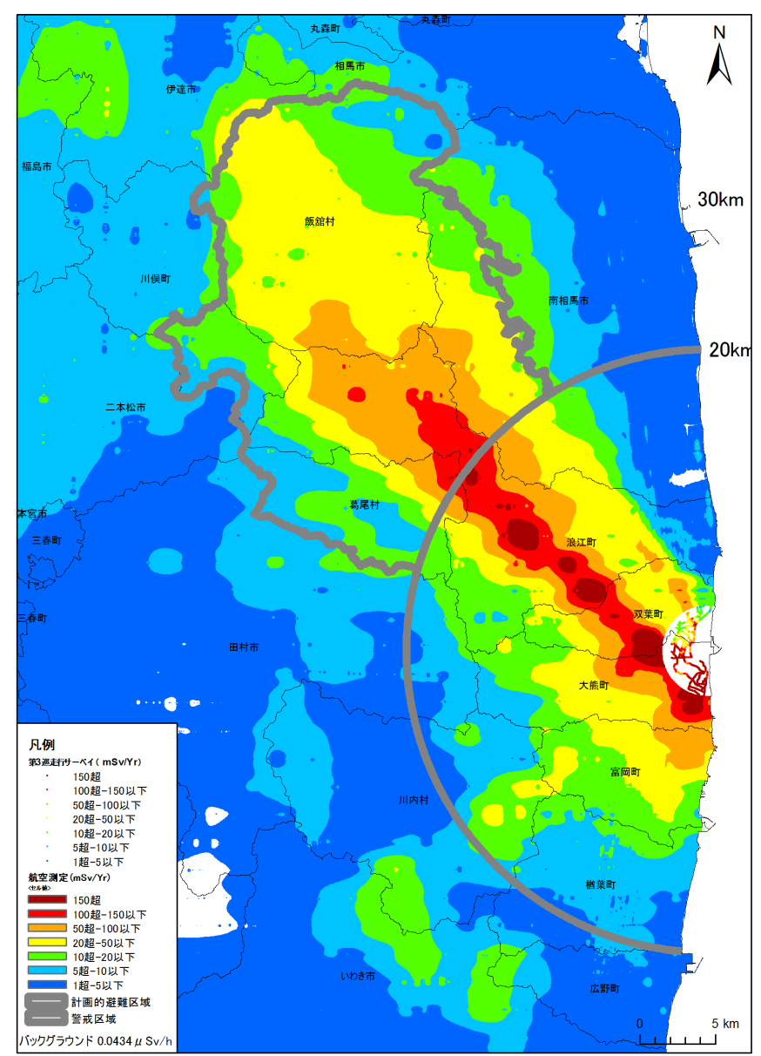
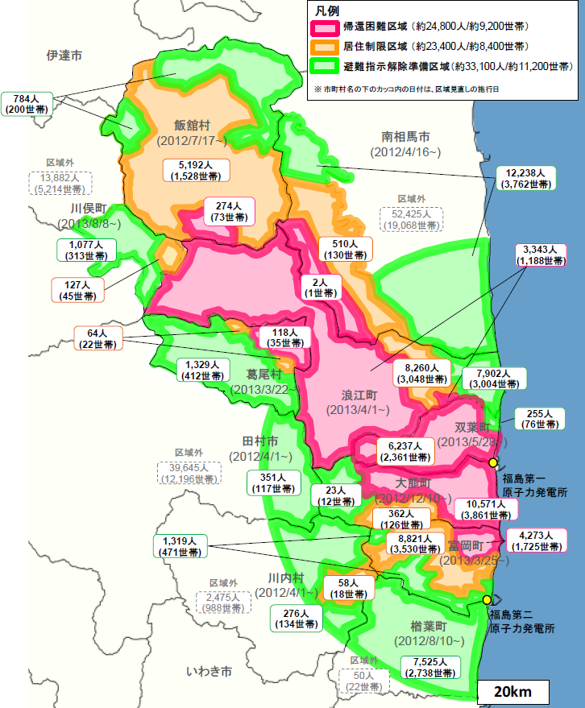
Evacuation :
Fukushima : 146,000 people
Exclusion zone : 81,300
Area 3 ( 50mSv< ) : 24,800
Area 2 (20 - 50mSv): 23,400
Area 1 ( 20mSv> ) : 33,100
Lifted on 1 April 2014
Miyakoji, Tamura city
Kawauchi villege
Stay overnights
Borrowed from Toshimitsu Homma
Notes:
16

Slide 17
ICRP and Fukushima
Soon after the Fukushima accident ICRP took a series of initiatives:
  In March an open letter of the ICRP Chair to express sympathy to the Japanese population and a free access to Publication 111 on the ICRP web site
  Creation in April of Task Group 84 on the initial lessons learned from the accident vis-à-vis the ICRP system of radiological protection
Visit of Japanese ICRP members in Belarus late September 2011
Launching in November 2011 of the ICRP Dialogue Initiative in Fukushima with Japanese, Belarus and Norwegian stakeholders to find ways to respond to the challenges of the long-term recovery in the affected areas
Creation in September 2013 of Task Group 93 to update ICRP Publications 109 and 111
17

Slide 18
The main ICRP Dialogue meetings
November 2011, Fukushima City: Rehabilitation after the Fukushima accident - Lessons from Chernobyl and ICRP Recommendations
February 2012, Date City: Accomplishments in Date City, and obstacles to and opportunities for further improvement
July 2012, Date City: Foodstuff, examining the challenges
November 2012, Date City : Education of children
March 2013, Date City: To return or not, to stay or leave in the affected areas
July 2013, Fukushima City: Focus on Iitate
November 2013, Iwaki City: Self-help actions in Iwaki and Hamadori
May 2014, Minamisoma City: The situation and challenges of Minamisoma
18

Slide 19
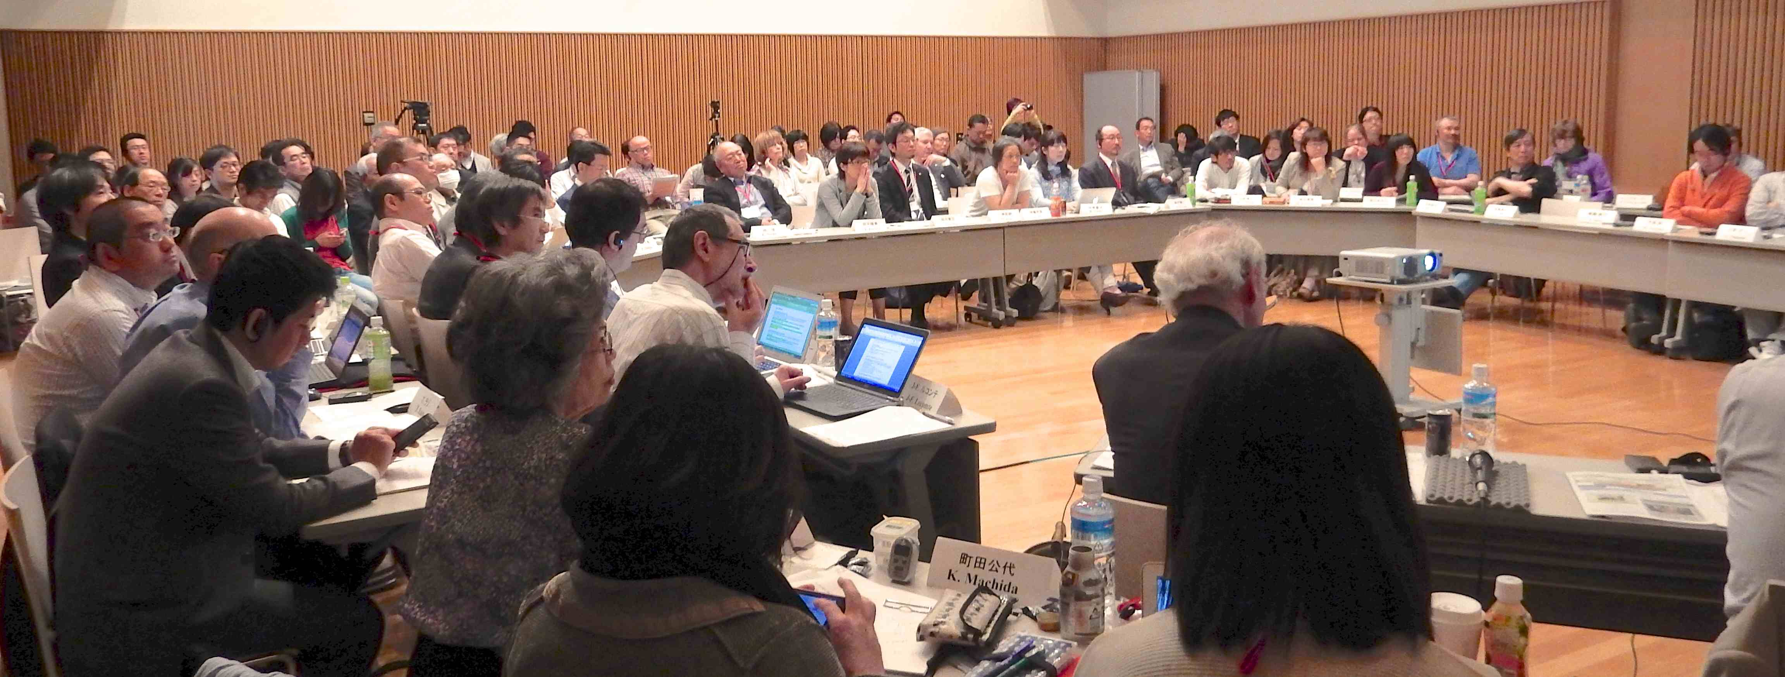
Format of the Dialogue meetings
Invited participants and observers: local and international
Round table meeting during 2 days
Presentations and structured discussions with facilitation (ICRP)
Use of common language
Open to media
Minamisoma meeting, May 2014
19

Slide 20
Some general lessons from the ICRP Dialogue meetings
The human consequences of the accident are massive and will be lasting
Local communities must be engaged in developing improvement projects and in assessing progress
Expertise and support must be at the service of local citizens
Individual monitoring (internal and external) and self-measurement of land and foodstuff are essential, and require outside support
Radiation protection culture is at least as important as remediation to improve safety and a feeling of security
Success depends on the combined action of authorities and self-help actions implemented by the affected population
20

Slide 21
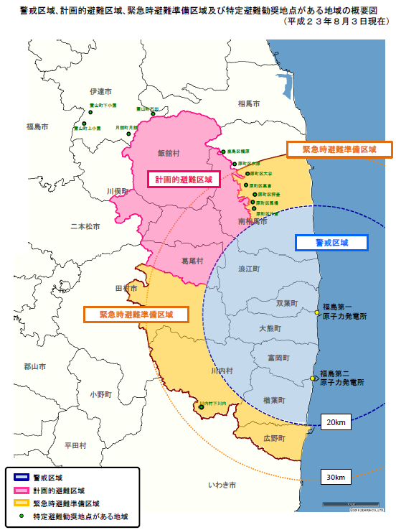
The experience of the Suetsugi community
- About 500 inhabitants before the accident, about 300 after -
Initiated by the “Suetsugi, Our Hometown” and the “Ethos in Fukushima” NGOs
Supported by volunteers - local and from all over Japan - including experts
Dialogue meetings and decision making together
Measurement of soil contamination, ambient dose rates, external and internal individual exposures
Sharing of information and comparing individual experiences
Use of social media (Web, Twitter,…) to exchange information and find support
Suetsugi
21

Slide 22
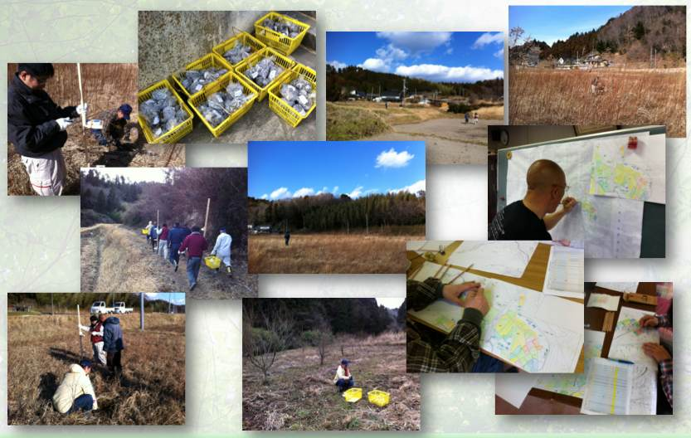
Measurements of soil contamination and ambient dose rates in rice paddies early 2012
22
Borrowed from Shinya Endo
Notes:
22

Slide 23
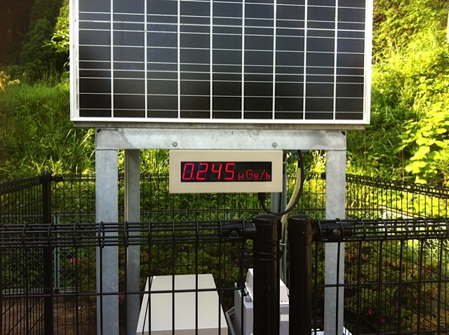
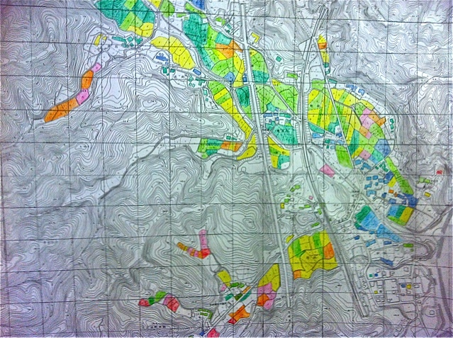
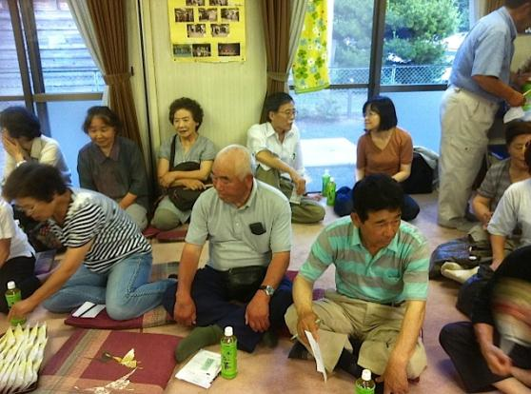
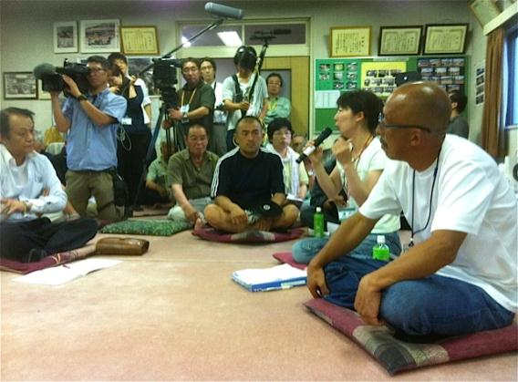
First meeting with ICRP – July 2012
- Questions and concerns -
23
Notes:
23

Slide 24
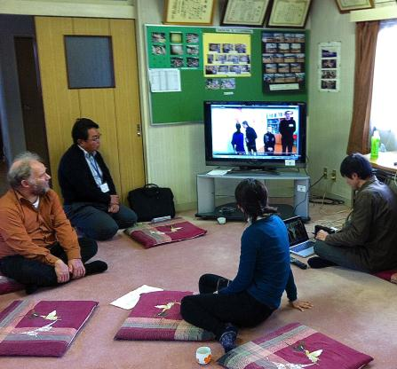
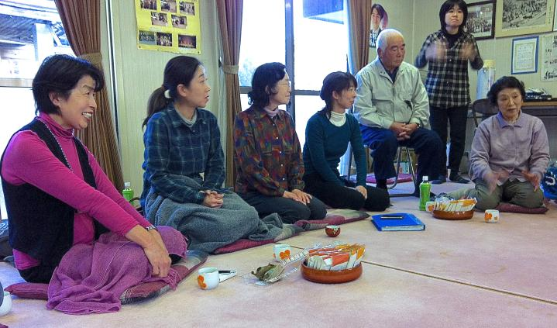
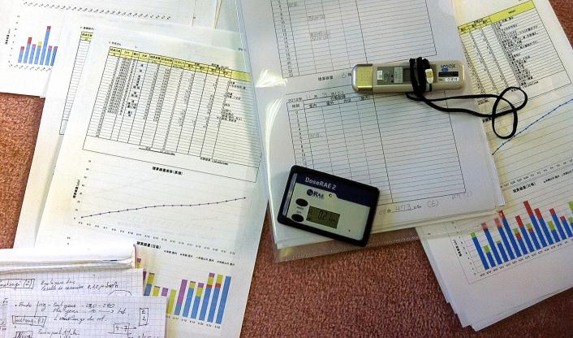
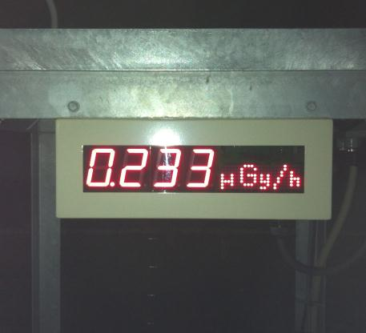
Second meeting with ICRP – November 2012
- Discussion on first measurements of external dose -
24
Notes:
24

Slide 25
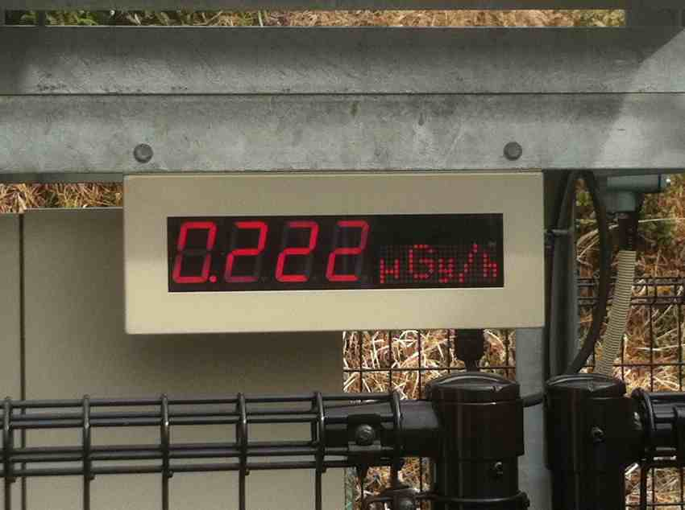
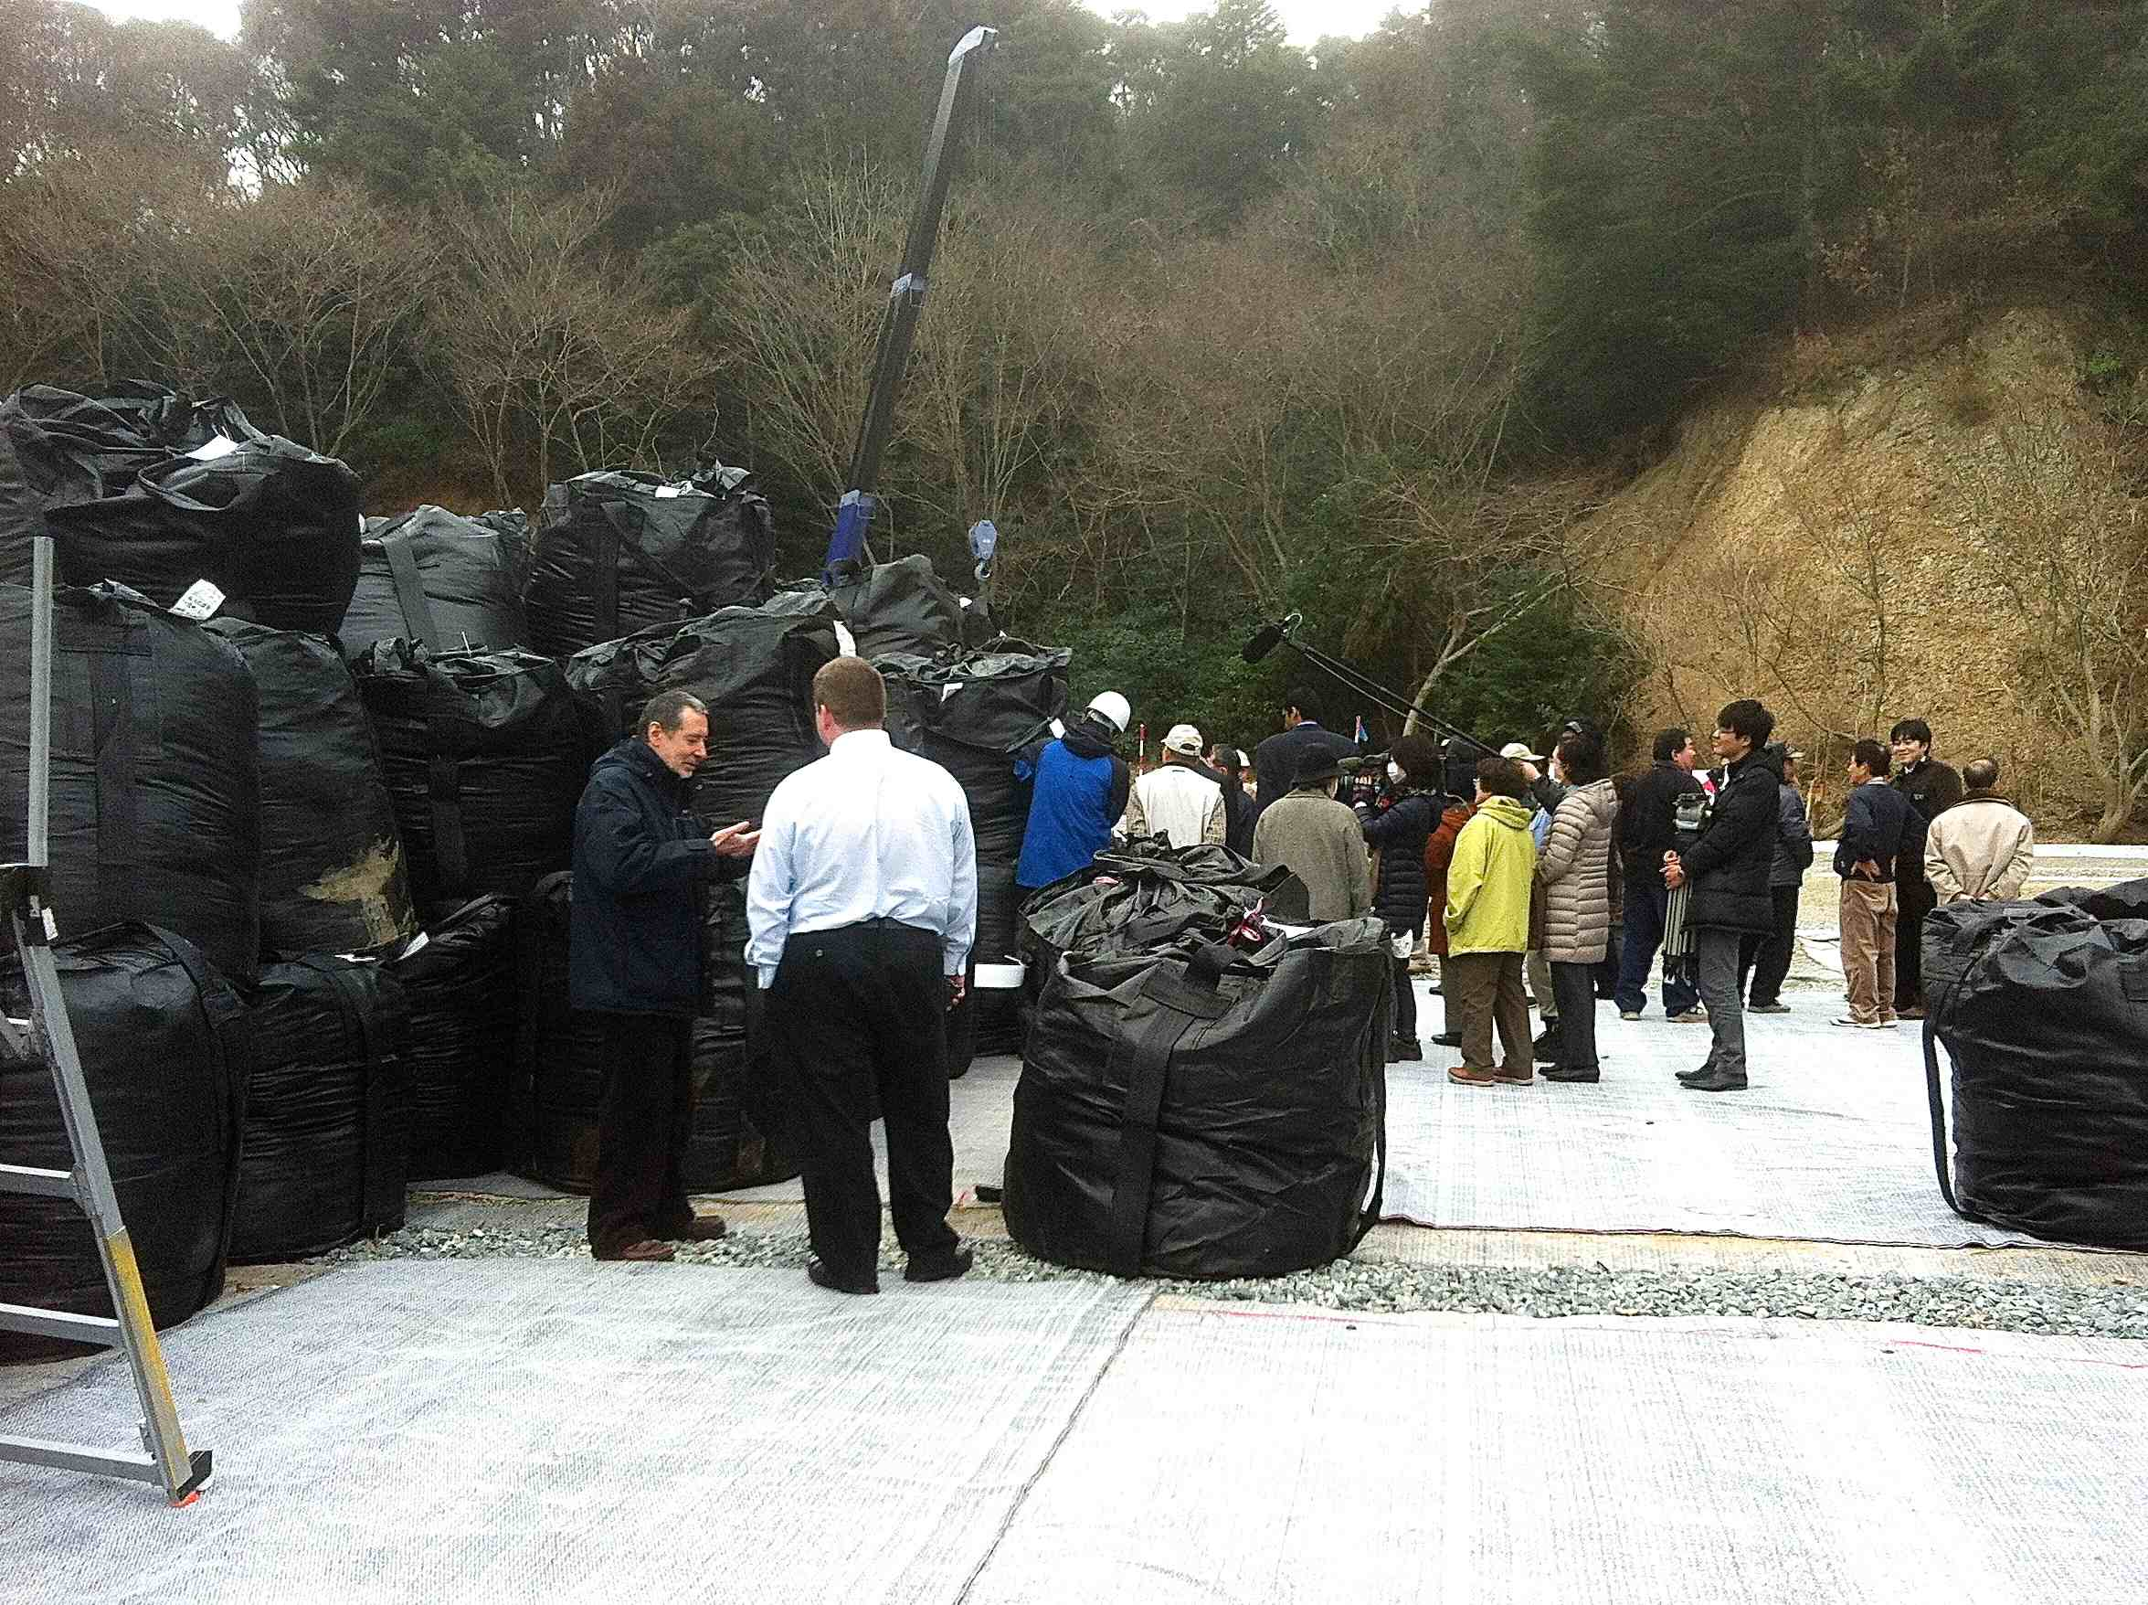
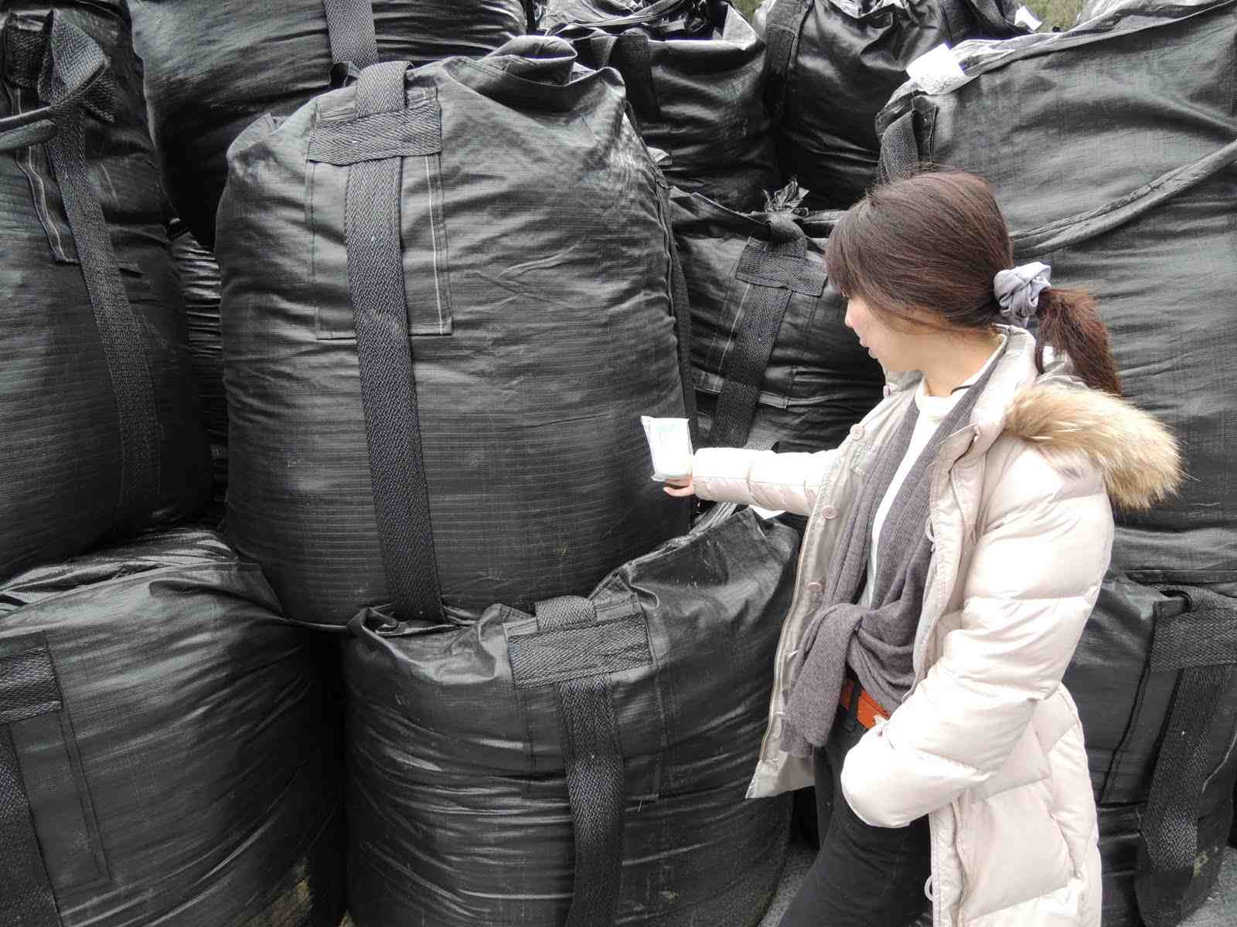
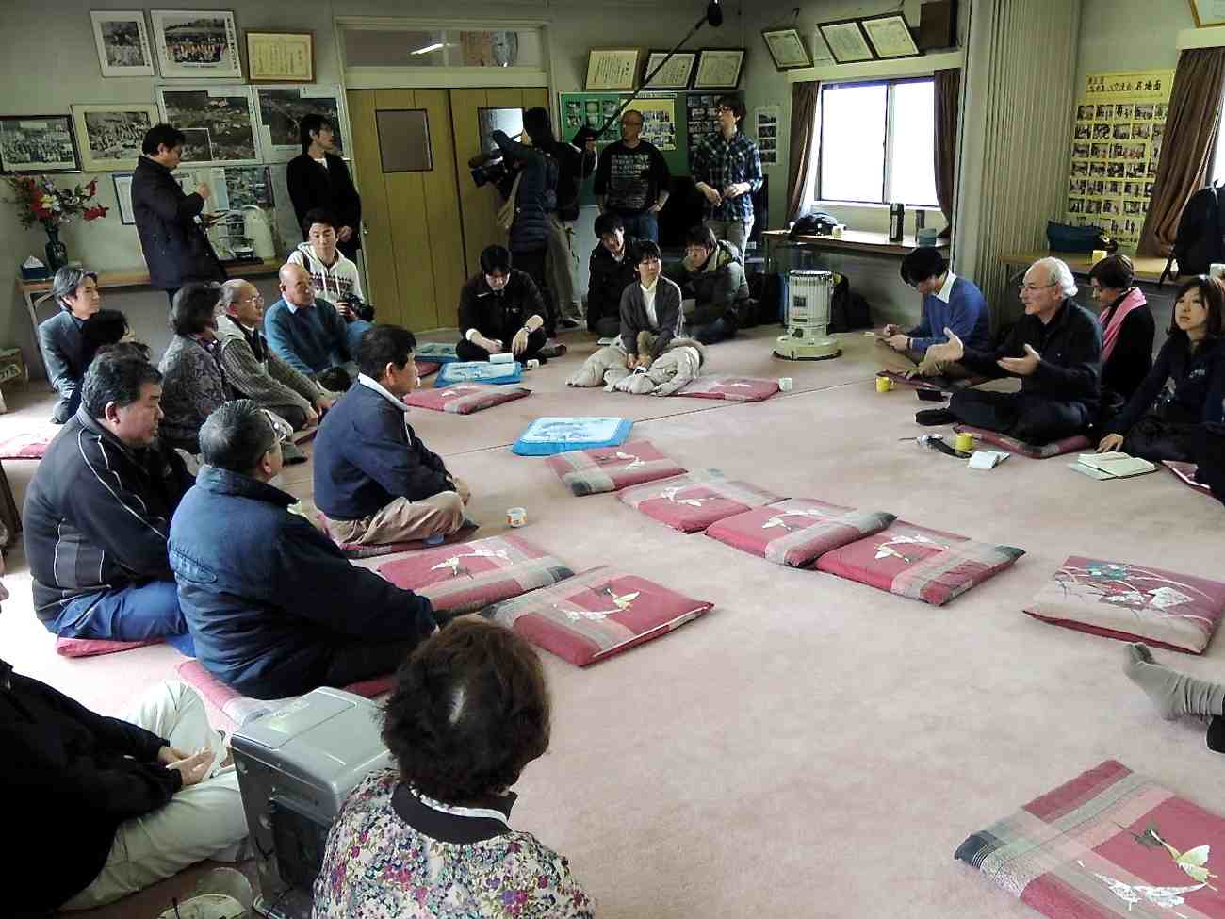
Third meeting in Suetsugi – March 2013
- Visit of the decontamination waste disposal site -
25

Slide 26
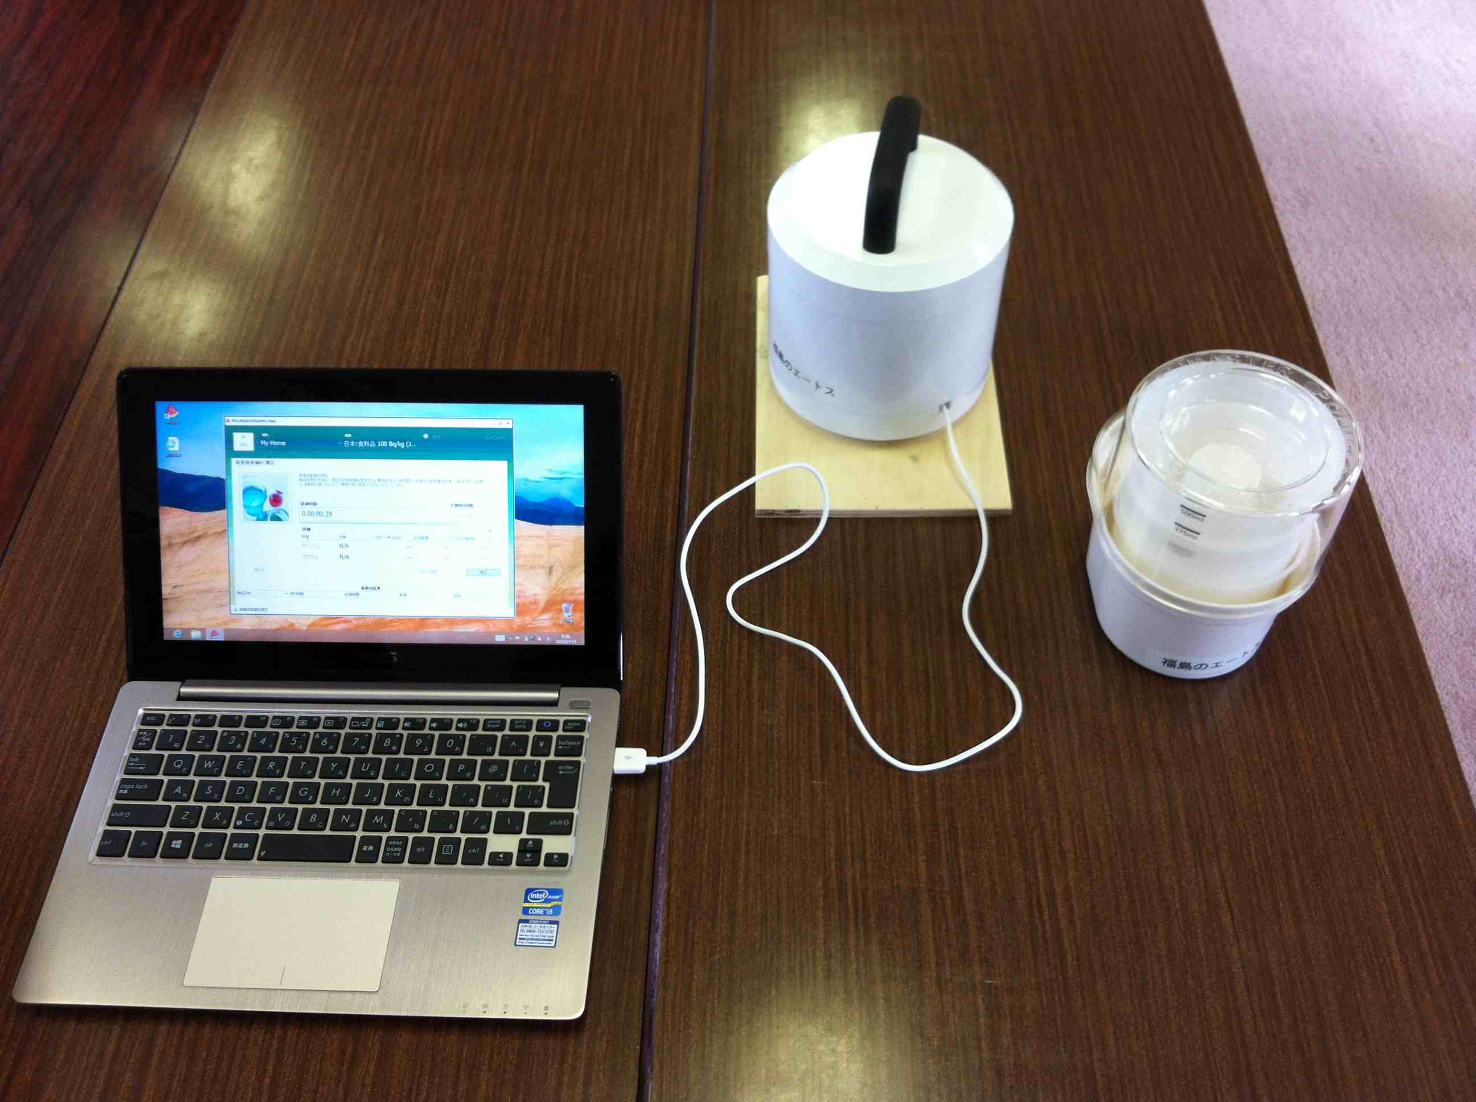
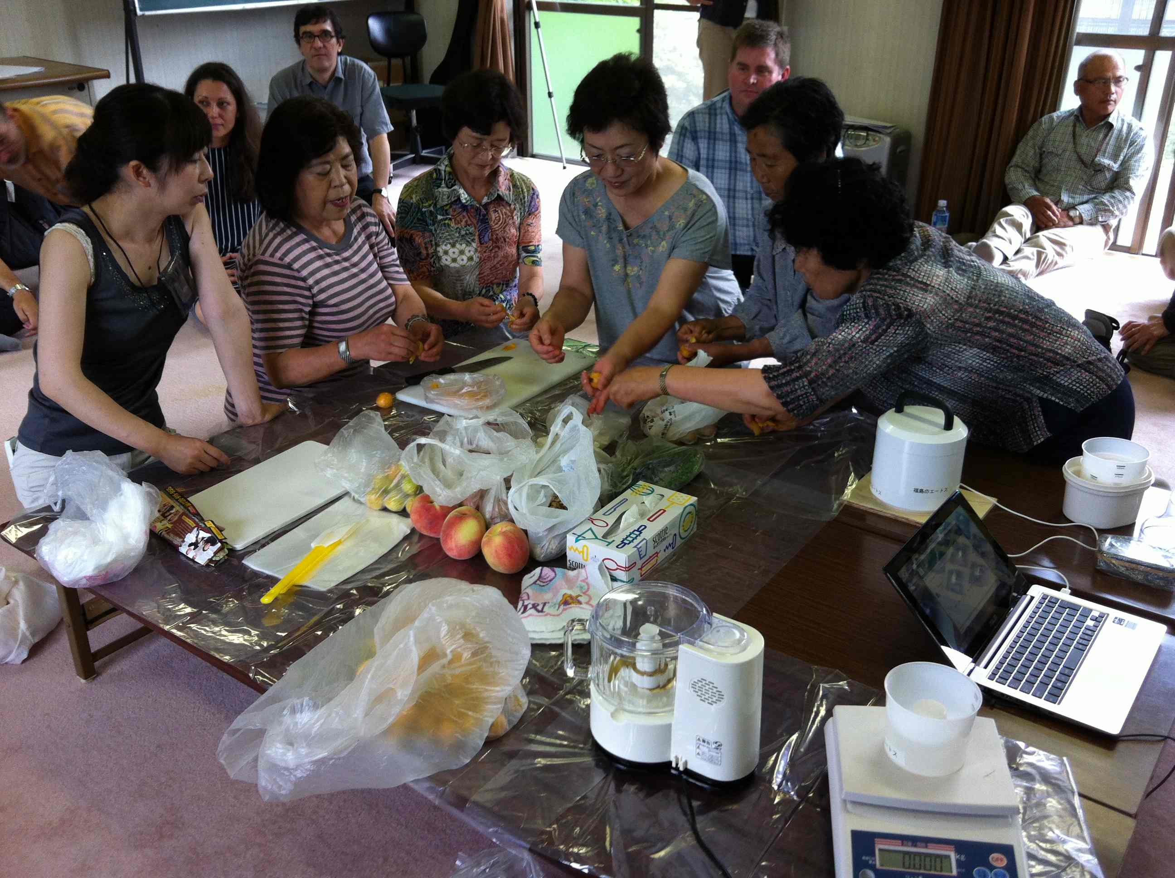
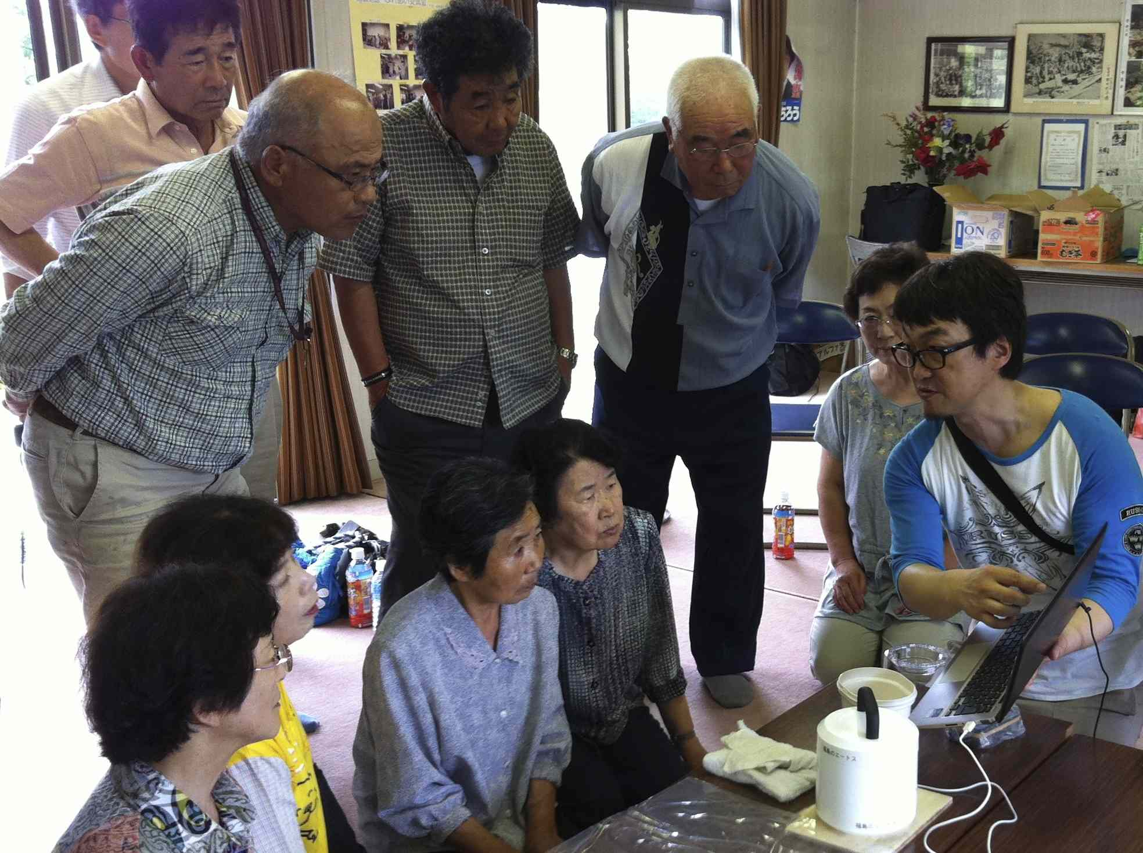
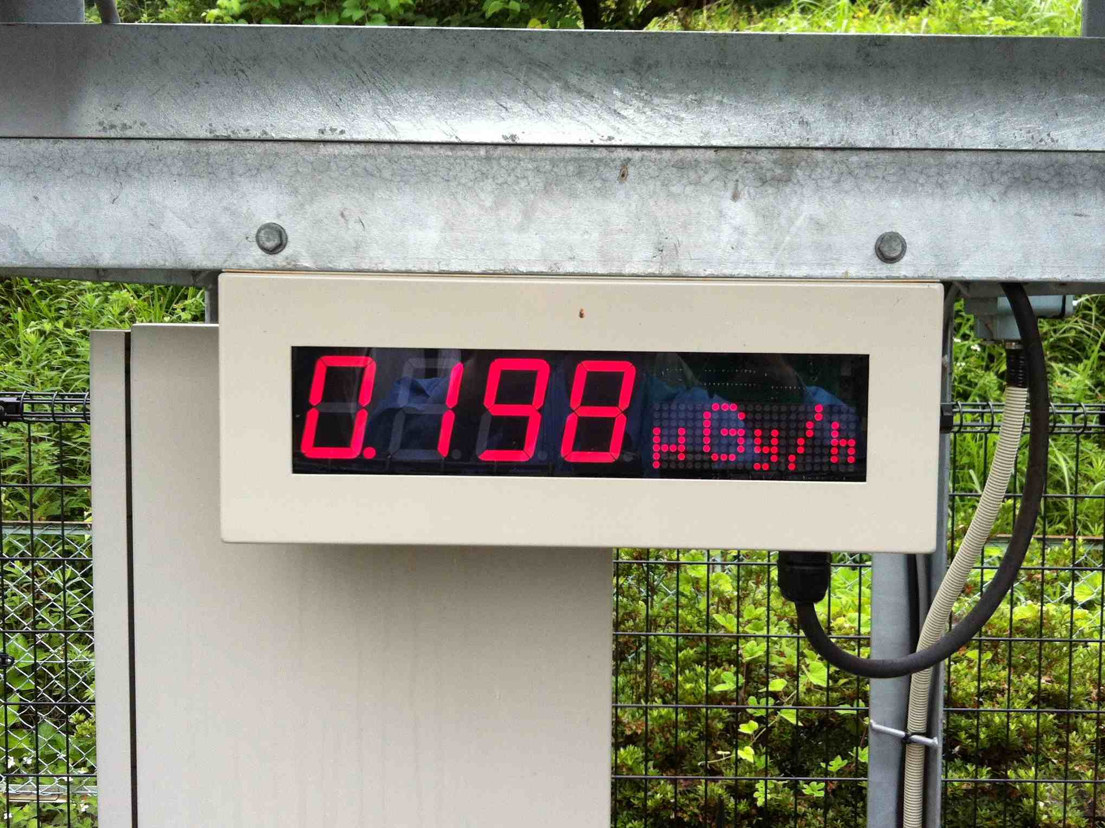
Fourth meeting with ICRP – July 2013
- Measurements of the products of local gardens -
26

Slide 27
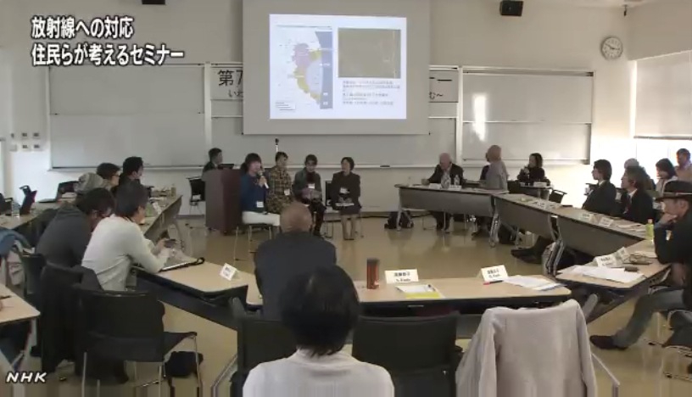
7th ICRP Dialogue in Iwaki – Iwaki, November 2013
- Testimonies of Suetsugi residents -
27

Slide 28
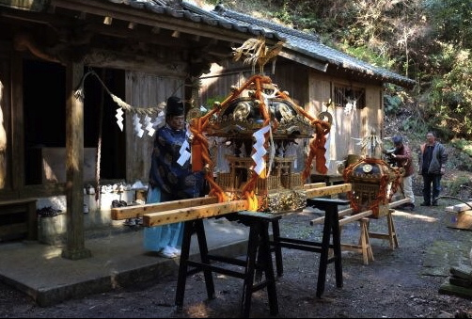
Preparing for the Suetsugi festival – April 2014
Photo © Jun Takai
28

Slide 29
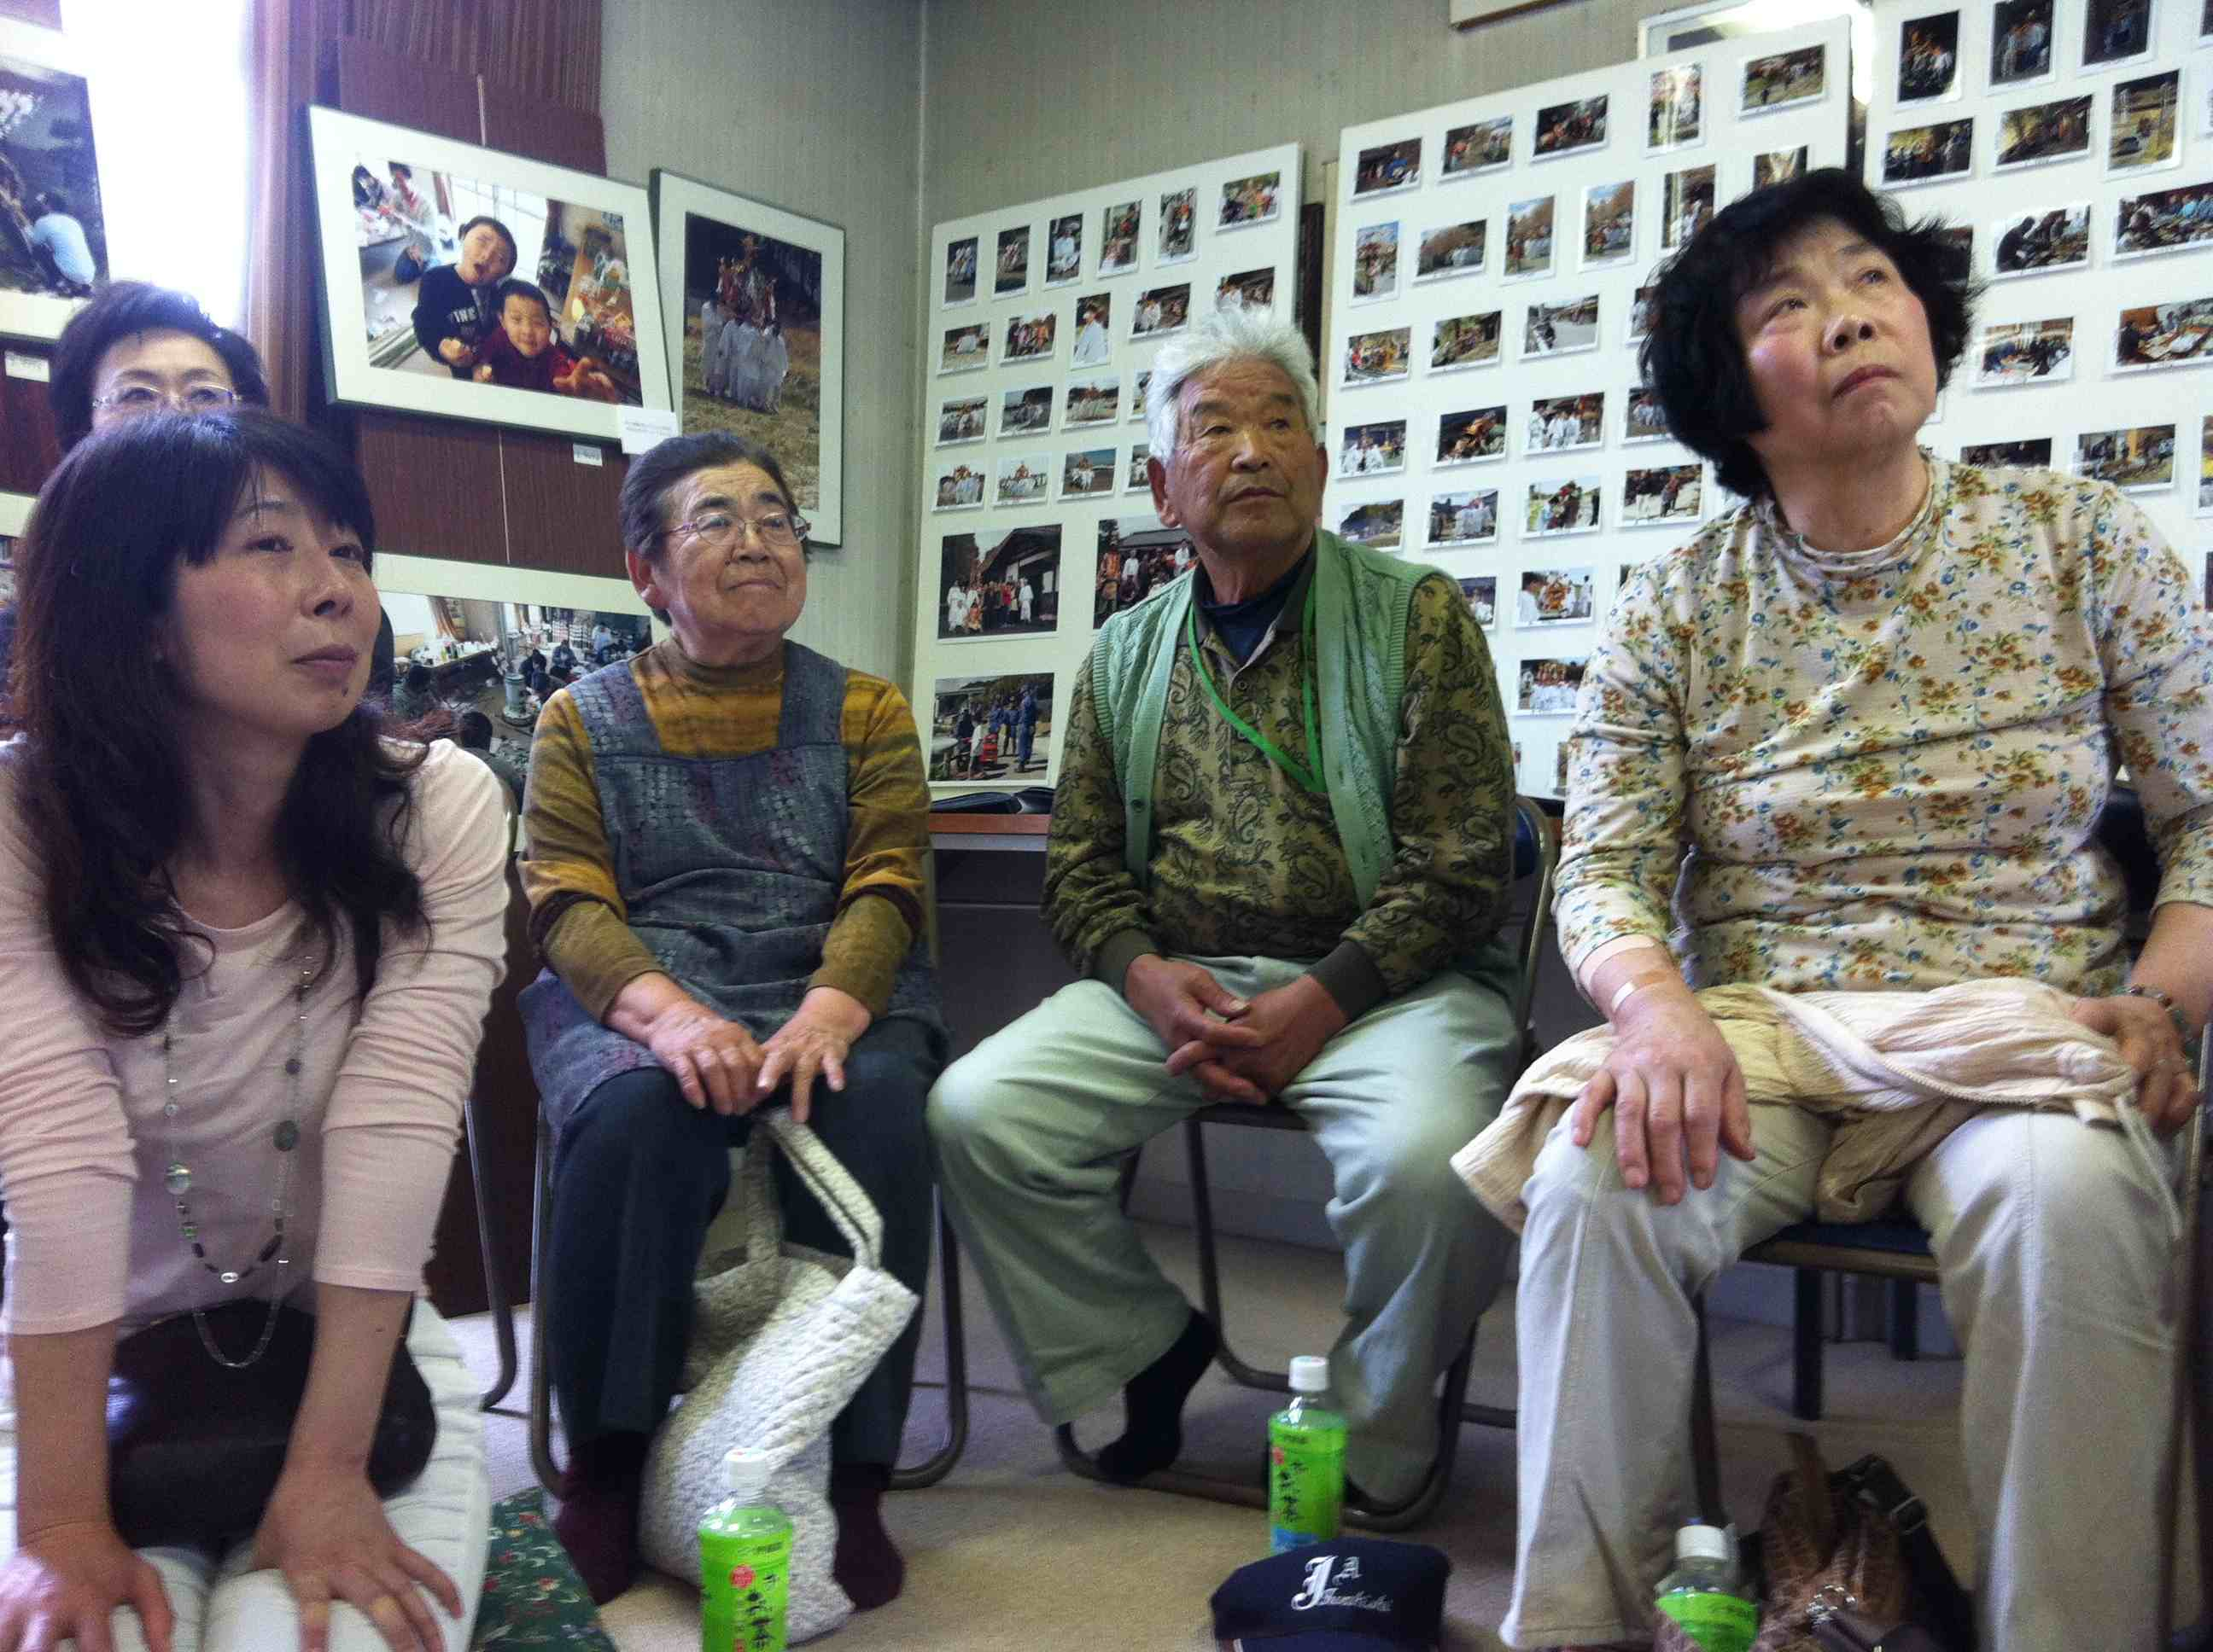
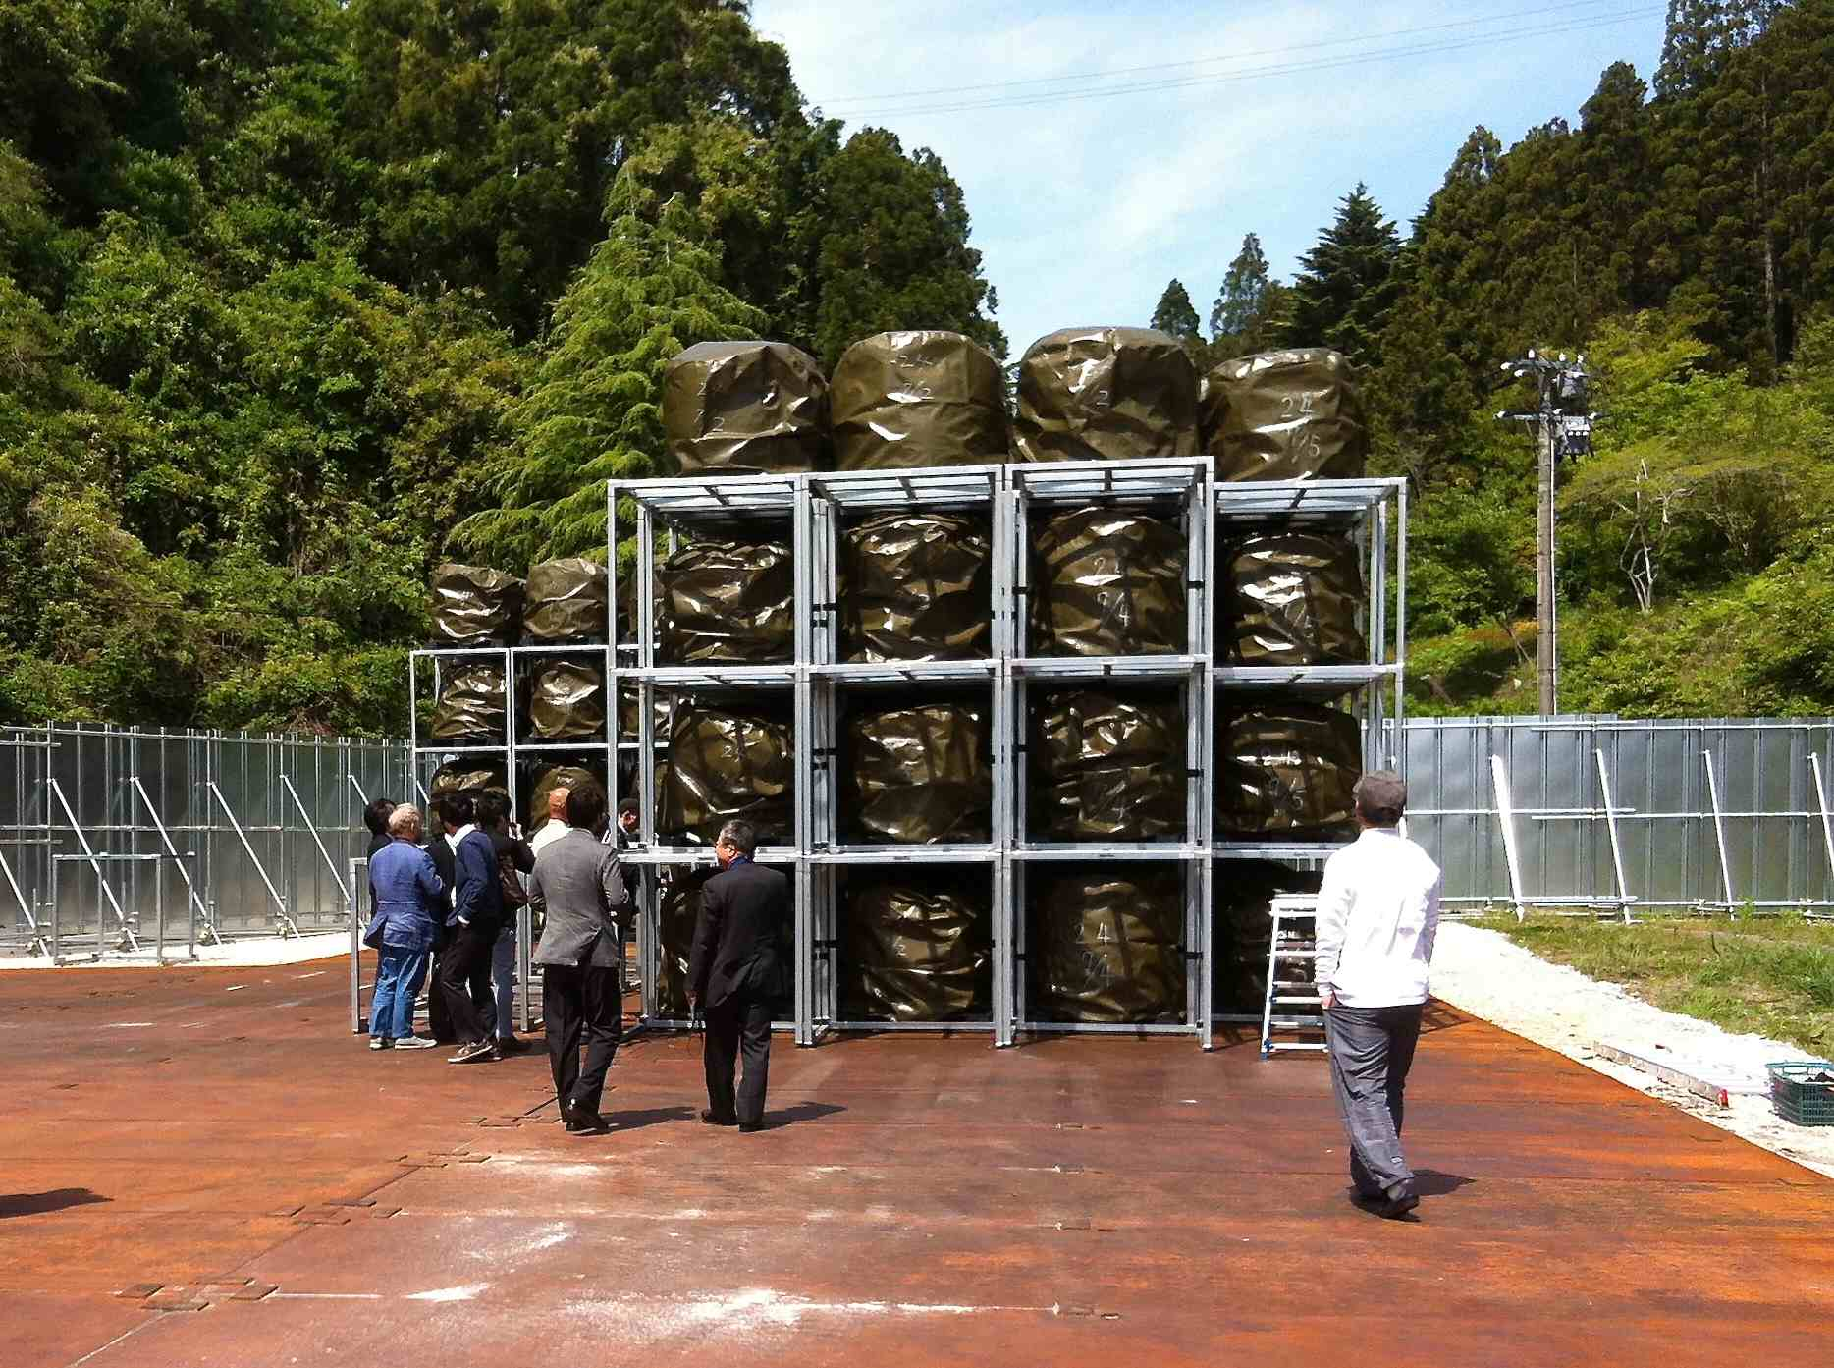
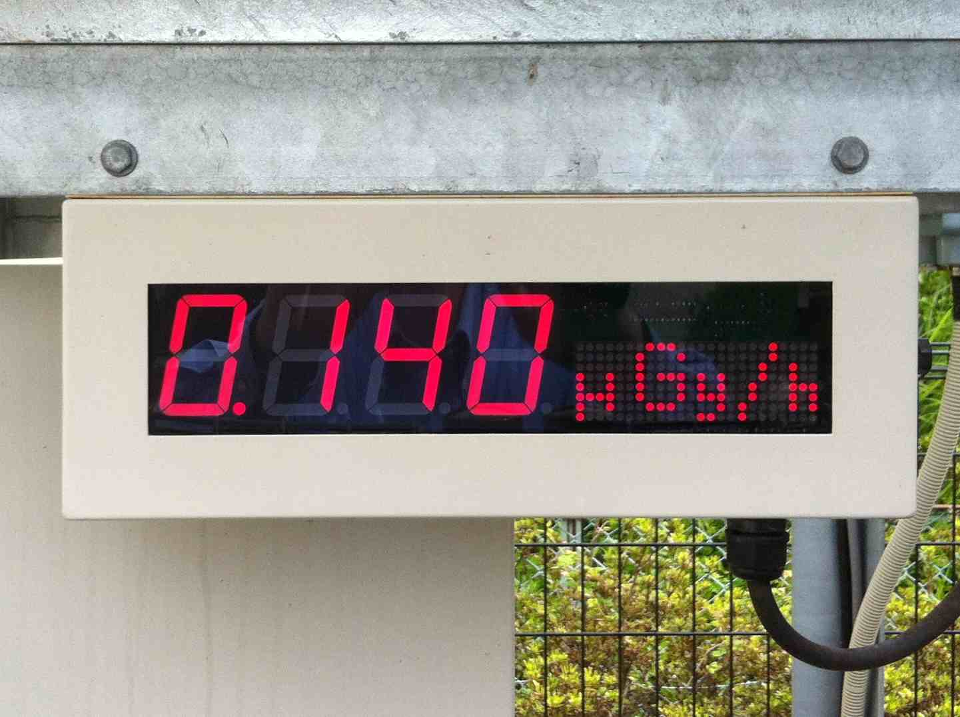
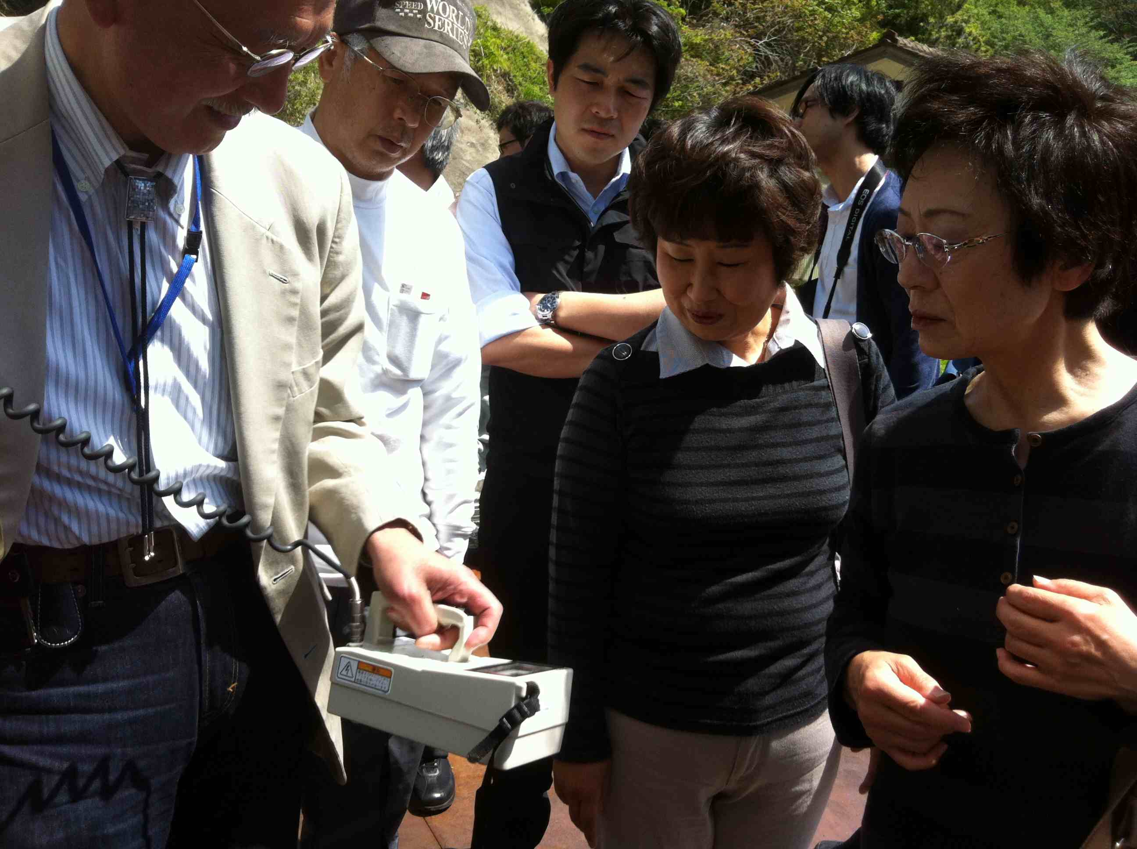
Fifth meeting with ICRP – May 2014
- Visit of the temporary storage site of the Iwaki incinerator fly ashes -
29

Slide 30
Lessons from the Suetsugi community
The Suetsugi experience confirms that the direct engagement of the affected people in the day-to-day management of a long-term contaminated territory is not only feasible but necessary for each individual to regain control on her/his radiological situation and also to restore her/his autonomy of decision
The people of Suetsugi who engaged in the rehabilitation of their living conditions with the support of voluntary experts also regained their dignity and feel more united than before the accident
After remaining a long time voiceless and awaiting actions of the authorities and experts, the people of Suetsugi again take initiatives and narrate their lives and achievements since Fukushima
30

Slide 31
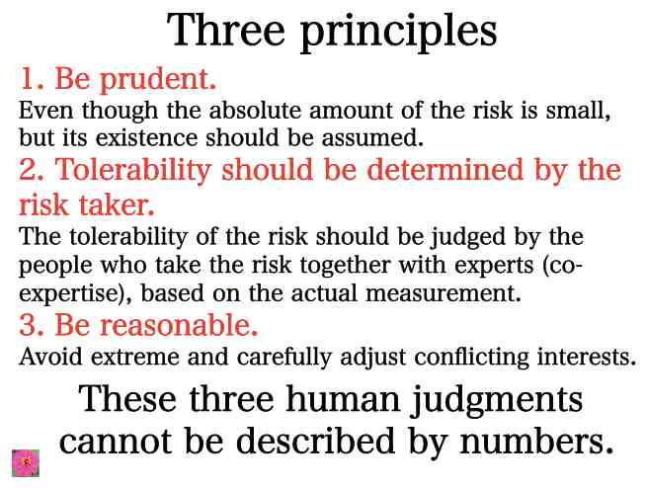
Borrowed from ETHOS in FUKUSHIMA
31

Slide 32
Concluding remarks (1)
The Chernobyl and Fukushima experiences demonstrate that the contribution of local actors through self-help protection is the “engine” of long term recovery
The role of experts is to serve local actors and to facilitate the development of their ability to assess and manage their own situation. Experts must evolve from the explanation of phenomena to the resolution of problems together with the affected people (co-expertise)
National resources must be mobilized to support community projects and local producers to improve living conditions in the areas affected
Places of dialogue to exchange experiences are essential to engage stakeholders and diffuse the practical radiation protection culture
32

Slide 33
Concluding remarks (2)
Overall, the ICRP system of radiological protection for long term recovery after a nuclear accident seems to work well
The main difficulty is with the understanding of the role of reference levels in the optimisation process. This point needs further clarification
More practical advice are also needed on the co-expertise process, the development of the practical radiation protection culture, and the self-help protection actions
The Japanese experience with the management of contaminated foodstuff, decontamination and waste management has to be integrated
More emphasize must be given on the human dimensions and the ethical values at stake with long-term recovery situations
All these points will be addressed by Task Group 93 on the update of ICRP Publication 109 and 111 chaired by Michiaki Kai and Toshimitsu Homma (Japan) and developed in cooperation with Japanese stakeholders and ICRP members involved in the ICRP Dialogue Initiative in Fukushima
33

Slide 34
References
ICRP (2009). Application of the Commission’s Recommendations to the Protection of People Living in Long Term Contaminated Areas after a Nuclear Accident or a Radiation Emergency. ICRP Publication 111. Annals of the ICRP, 39 (3).
IAEA (2000). Restoration of Environments with Radioactive Residues. Proceedings of an International Symposium, Arlington, Virginia, USA, 29 November – 3 December 1999. IAEA.`
ETHOS IN FUKUSHIMA (2011). http://ethos-fukushima.blogspot.fr/p/icrp-dialogue.html
Lochard, J. (2013). Stakeholder Engagement in Regaining Decent Living Conditions after Chernobyl. In D. Oughton & S. O. Hansson (Eds.), Social and Ethical Aspects of Radiation Risk Management. Elsevier Science, 311-332.
34

Slide 35
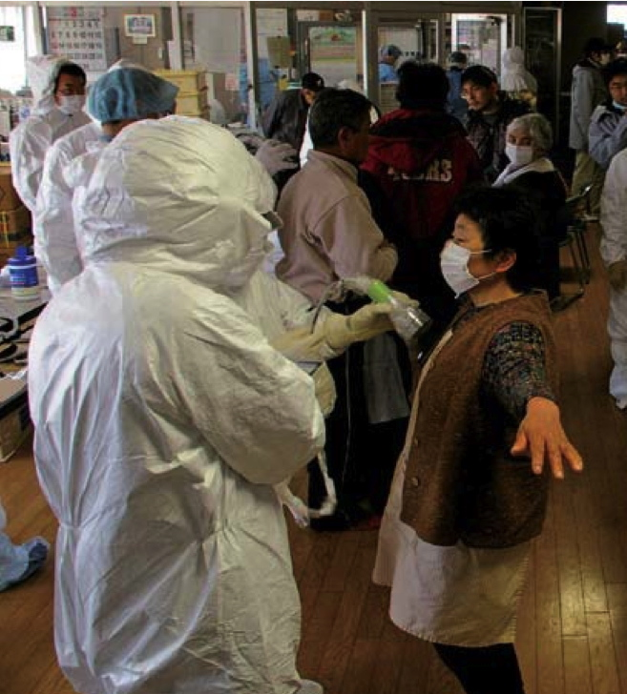
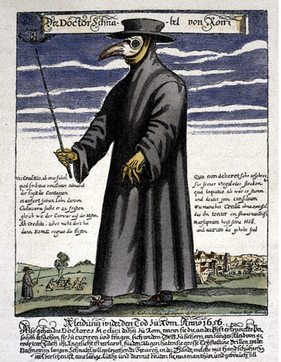
Thank you for your attention
35

Slide 36

www.icrp.org

