Slide 1
The Human Dimension of Remediation after a Nuclear Accident:
From Experience to ICRP Recommendations
International Experts’ Meeting on
Decommissioning and Remediation after a Nuclear Accident
28 January – 1 February 2013
Vienna, Austria
Jacques Lochard, ICRP Main Commission
Chair of Committee 4

Slide 2
Content
The characteristics of living in a contaminated area after a nuclear accident
Lessons from Chernobyl on the involvement of stakeholders
The recommendations of the ICRP
2

Slide 3
Living in a contaminated area (1)
The radioactive contamination: a disquieting presence
  Invisible, impalpable, uncatchable
  Everywhere in the places to live: intrusion in the private sphere
  Durable: several generations
An unspeakable presence: no experience, no memory, no words in the common language
All dimensions of daily life are affected: health, environment, social life, production and distribution of foodstuffs and commodities… but also psychological, aesthetic and ethical aspects
Everyone is involved: residents, local authorities and professionals, local organizations and businesses,…
Strong concern about the future and particularly of children
3

Slide 4
Living in contaminated areas (2)
For each individual, the presence of radioactivity modifies her/his relationship to risk, to the land, to other people:
  Everyone is faced with the thought of death
  Environment, and particularly foodstuffs, are perceived as hostile
  Goods and products have less or no value anymore
  The common heritage is devaluated
  Residents of the affected areas feels discriminated
General feelings among the population:
  Loss of control on daily life
  Loss of confidence in authorities and experts
  Uncertainties on the long-term effects of radioactivity
  Feeling of helplessness, abandonment and exclusion

Slide 5
Living in contaminated areas (3)
Actions implemented by authorities and experts reinforce the feeling of exclusion among the population:
  Contamination measurements reduce quality to figures
  Standards and norms divide the world in “good” and “bad”
  Countermeasures are intrusive and generate interdictions
  The difficulties to manage the complexity of the situation leads everyone to look for scapegoats
  Politicians and experts put the blame on the population: theory of radiophobia!
  The affected population accuses public authorities of mismanagement, negligence or even abandonment
  This can turn into strong social distrust very difficult to manage (cf. the Soviet Union situation in the late 80s)

Slide 6
Living in contaminated areas (4)
Attitudes and individual strategies faced with contamination
  Denial of the risk
  Resignation and fatalism
  Anxiety and stress
  Management of the situation
Each individual is permanently confronted to the questions : “Should I stay or leave the area?”, “Should I return or not?”
To answer to such question people want to know among others:
  What is the risk?
  What are the means to protect themselves and their loved ones?
  If it is possible to ensure decent and sustainable living conditions in the affected areas including respectable lifestyles and livelihoods
In

Slide 7
Lessons from Chernobyl on stakeholder involvement (1) Ethos project (1996-2001) and CORE Programme (2004-2008)
  Faced with the complexity of the situation the characterization of the radiological situation is a difficult process:
    The ‘statistical’ approach does not account for individual situations, which is the main interest of people
    Experts do not necessarily know the local living and customs of the inhabitants: need to cooperate with the population (co-expertise)
  Characterization of individual situations revealed:
    The non-homogeneity of local contamination
    The wide distribution of individual exposures according the different behaviours and habits
    The existence of considerable leeway at the individual level to reduce exposure
7

Slide 8
Lessons from Chernobyl on stakeholder involvement (2)
When people understand:
    Where, when and how they are exposed?
    What can they do to protect themselves ?
  they spontaneously participate to their own protection and regain control on the situation
  To allow people to orient themselves the radiation monitoring must ensure measurements of:
    Ambient dose rates in living and recreation places
    Contamination of self-produced or gathered food
    Internal contamination of persons
  to help establish links between the activities and lifestyle of the individuals and their levels of exposure
8

Slide 9
Lessons from Chernobyl on stakeholder involvement (3)
  Chernobyl experience showed that it was possible to develop, with the help of local professionals (health personnel and teachers) a practical radiation protection culture allowing individuals:
    To interpret results of measurements
    To orient themselves in relation to radioactivity in everyday life
    To bring elements to make decisions and take actions
    To assess the effectiveness of the protective actions they implement themselves
  A proposed definition of practical radiation protection culture: the knowledge and skills enabling citizens to make choices and behave wisely in situations involving exposure to ionizing radiation
9

Slide 10
Lessons from Chernobyl on stakeholder involvement (4)
  The pluralism of sources of measurement (public and private local, regional and national actors) and the establishment of places for dialogue are important to ensure confidence of the population in the progress of the remediation, the development of a common language between all involved stakeholders and the dissemination of the practical radiation protection culture in all segments of the population
  Finally, experience has also shown that when people have direct access to measurements, standards cease to be a limiting/blocking factor for their involvement in the rehabilitation process, but become benchmarks to guide their daily actions and behaviours
10

Slide 11
In summary
  Living in a contaminated environment is a complex situation generating a lot of questions and concerns among the affected population
  Exposures are driven by individual behaviours and the socio-economic situation
  The direct involvement of inhabitants and local professionals in the day to day management of a contaminated territory is feasible and also necessary to break the vicious circle of loss of control and exclusion
  This involvement must rely on the dissemination within all segments of the population of a “practical radiation protection culture” based on 3 pillars: radiation monitoring, health surveillance and education at school
11

Slide 12
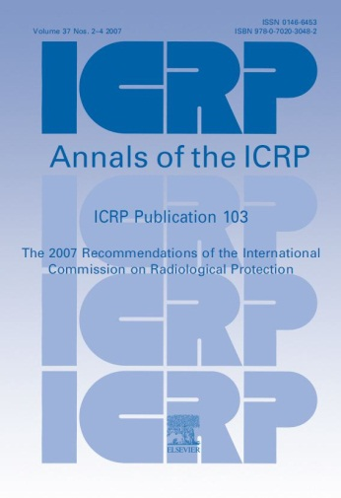
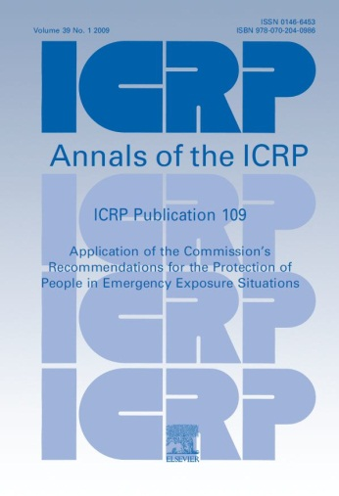
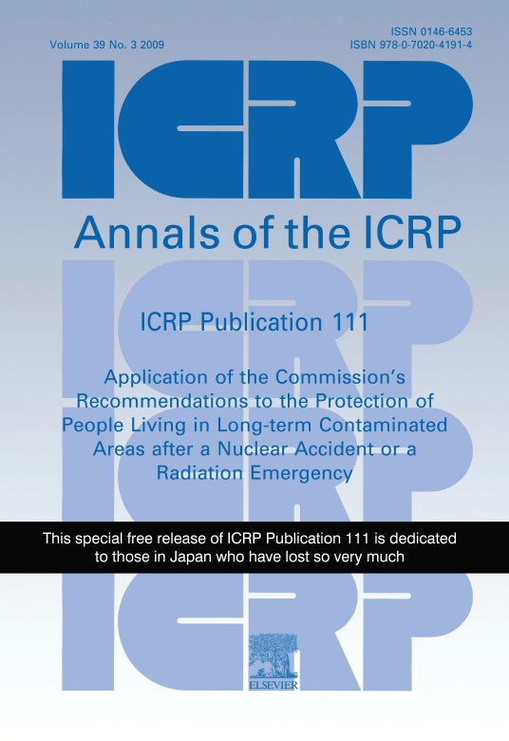
Relevant ICRP Publications
Publication 103 (2007)
Fundamental
Recommendations
Publication 109 (2009)
Emergency
Situations
Publication 111 (2009)
Post-Accident
Recovery
12

Slide 13
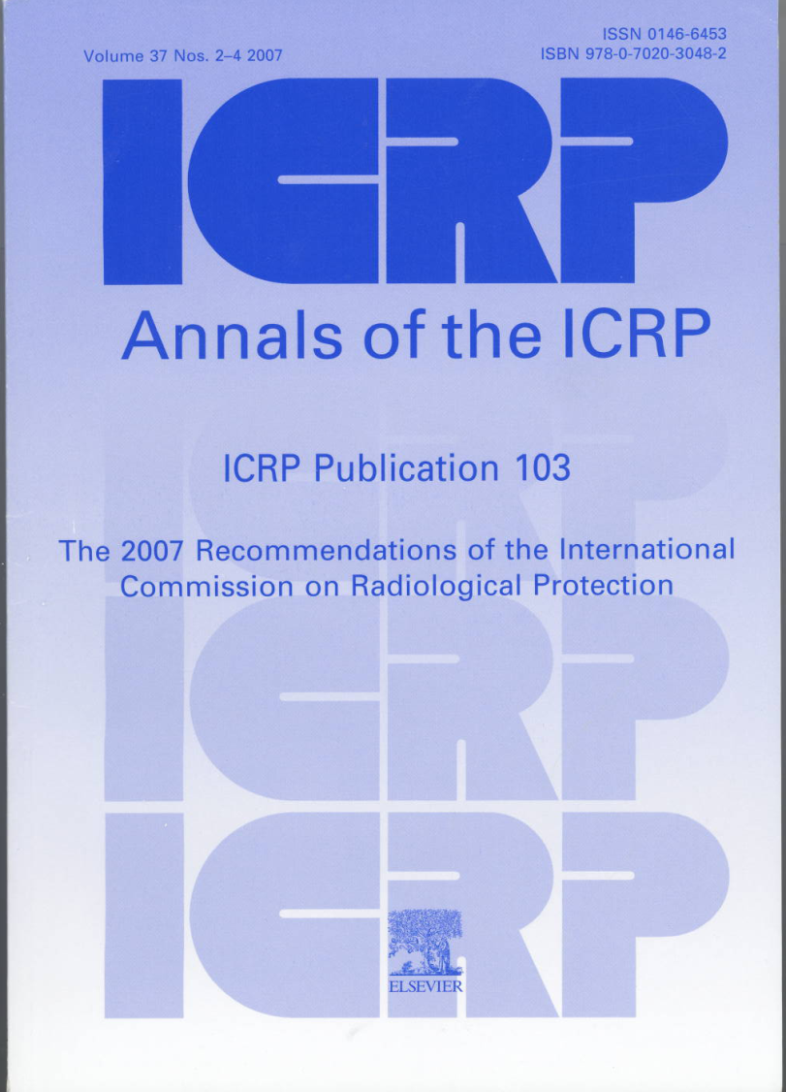
The aims of the Recommendations
To contribute to an appropriate level of protection for people and the environment against the detrimental effects of radiation exposure without unduly limiting the desirable human actions that may be associated with radiation exposure (ICRP 103, § 26)
13

Slide 14
Definition of an exposure situation
“The process causing human exposures from natural and man-made sources”
“Protection can be achieved by taking action at the source, or at points in the exposure pathways, and occasionally by modifying the location or characteristics of the exposed individuals”
Source
Pathways
Exposed
individuals
14
Notes:
30/01/13
14

Slide 15
The three types of exposure situations
Existing exposure situations : when exposures result from sources that already exist when decisions to control them are taken. Characterization of exposures is a prerequisite to their control
Planned exposure situations : when exposures result from the deliberate introduction and operation of sources. Exposures can be anticipated and fully controlled
Emergency exposure situations : when exposures result from the loss of control of a planned exposure situation, or the sudden irruption of an uncontrolled source (malicious act). These situations require urgent and timely actions in order to prevent exposures to occur or to mitigate them
The Commission defines long term exposures resulting from a nuclear accident as an existing exposure situation
15
Notes:
30/01/13
15

Slide 16
The objective of protection
To reduce and to maintain exposures as low as reasonably achievable
taking into account economic and societal factors with restrictions
on individual doses
    The general objective is to keep exposure below 100 mSv
    “At doses higher than 100 mSv, there is an increased likelihood of deterministic effects and a significant risk of cancer”. (ICRP 103, § 236)
  For the protection of the public in case of a nuclear accident with potential long term consequences the Commission is recommending to select reference levels:
    In the 20–100 mSv/year range for the emergency exposure situation
    In the lower part of the 1–20 mSv/year range for the existing exposure situation, with the long term objective to reduce and maintain exposures below 1 mSv/year
  Authorities may select values of reference levels depending on the scale of the accident and the local circumstances
16

Slide 17
Transition from the emergency to the existing exposure situation after an accident
  Characterisation of the exposure situation is the prerequisite to take control of the exposures. The process may take months (even years) and is part of the urgent actions to be implemented in the emergency situation
  Characterization can be considered as achieved when the authorities have a fairly good knowledge of where, when, and how people are exposed (and will be exposed in the future) in the affected areas. This in turn allows:
    For the authorities to decide about permanent and temporary relocation and/or return home and the most effective protection strategy
    For the population to decide to leave or to stay and to participate to its own protection with the support of authorities and experts
  The transition from the emergency to the existing exposure situation is a decision taken by authorities when they have enough information to consider that the exposures can be reasonably controlled and the conditions and means to maintain sustainable societal and economic living conditions of the affected population are in place
  .
17

Slide 18
Optimization of the protection strategy
A combination of protection actions implemented by authorities at the national and local level and by the affected population itself
The Commission has developed the concept of ‘self help protective actions’ to characterize these protection actions
The objective is to reduce all exposures ALARA with priority given to protect people with the highest exposure (Equity)
It is the responsibility of authorities:
  to establish conditions to allow the effective engagement of the local stakeholders
  to set up the conditions and means for local monitoring
  to provide detailed information on the exposure situation and ways to reduce doses
  to evaluate the performance of the protection strategy and to report regularly about the progress to the affected population
18

Slide 19
In summary
Emergency Exposure Situation
Reference level in the 20-100 mSv/year range
Protection actions to reduce and maintain exposure ALARA driven by urgency
Characterization of the radiological situation
Setting-up radiation monitoring, health surveillance and foodstuffs management
Existing Exposure Situation
Reference level in the lower part of the 1-20 mSv/year range with the long term goal of 1 mSv/year
Protection actions to reduce and maintain exposure ALARA driven by the improvement of living conditions
Development of self-help protection and radiation protection culture
Decision by
authorities
19

Slide 20
Concluding remarks
The first elements of the return of experience of Fukushima show that there are no significant differences with regard to Chernobyl general feelings and attitudes of the affected populations
The Dialogue initiative launched by the ICRP to facilitate cooperation between all stakeholders of Fukushima shows that the advice of the Commission, particularly those of Publication 111, found a favourable response from the local authorities and professionals as well as from the population
The system of protection developed by ICRP for post-accident remediation aims at promoting protection (by keeping exposures ALARA), treating everybody fairly while respecting the fundamental values of liberty, autonomy and dignity of the affected people
20

Slide 21

www.icrp.org

