Slide 1
Radiological Protection and Public Communication
Fukushima Ministerial Conference on Nuclear Safety
15 - 17 December , 2012
Koriyama City, Fukushima Prefecture, Japan
Christopher Clement, ICRP Scientific Secretary
Jacques Lochard, ICRP Main Commission

Slide 2
Radiological Protection and Public Communication
ICRP advice for post-accident recovery

Slide 3
ICRP
Established in 1928, ICRP is a charity providing independent recommendations and guidance on radiological protection for the public benefit
The System of Radiological Protection is the basis for radiological protection standards, legislation, guidance, programmes and practice worldwide
Members
200+ leading scientists and policy makers from 30+ countries
Unpaid volunteers & a Scientific Secretariat

Slide 4
Good public communication can:
Help people be safe
Directly improve living conditions
Poor public communication can:
Create and reinforce misconceptions about safety
Damage confidence in authorities and experts
Increase stress and anxiety

Slide 5
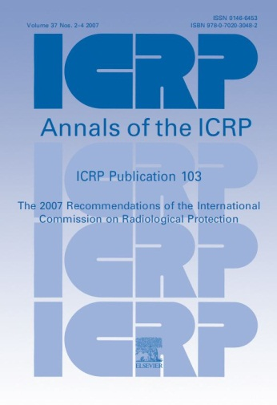
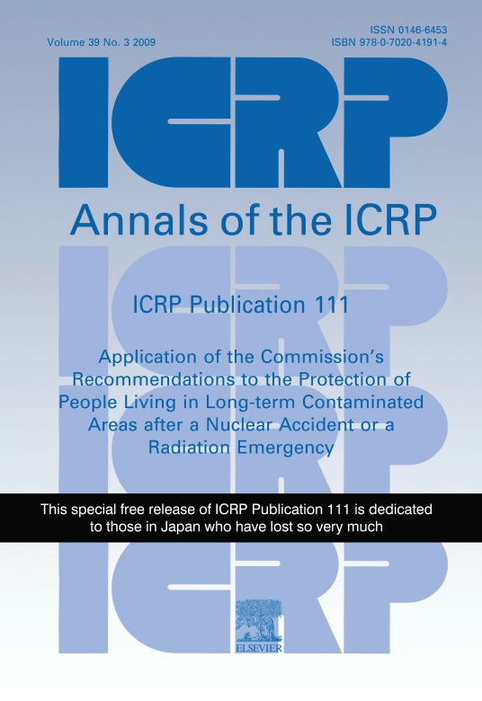
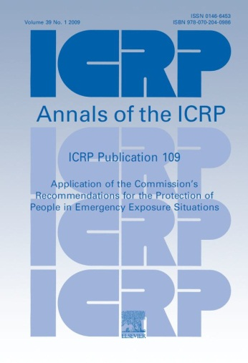
ICRP Publications
Publication 111
Post-Accident Recovery
Publication 103
Fundamental
Recommendations
Publication 109
Emergency
Situations

Slide 6
Protection Strategy
Protective actions implemented centrally and locally by authorities, experts, and professionals
Self-help protective actions directly implemented by the exposed individuals with the support of the authorities
Protection Strategy
Actions by authorities
Self-help actions

Slide 7
Protective Actions
Implemented by Authorities
Clean-up of buildings
Remediation of soil and vegetation
Changes in animal husbandry
Provision of clean foodstuffs
Waste management
Health surveillance
Monitoring of the environment and produce
Provision of information, guidance, instruction and equipment
Education of children, and information for particular exposed groups and the public at large

Slide 8
Self-help Protective Actions
Informed actions taken by inhabitants of affected areas to reduce their exposure and the exposure of the people for whom they have responsibility (e.g. children, elderly)
Why?
Exposure is largely driven by individual behaviour
Individuals regain control of their situation
Inhabitants have local knowledge
Self-help protective actions complement and are supported by actions taken by authorities

Slide 9
Self-help

Slide 10
Local Forums
Authorities should facilitate the setting-up of local forums involving representatives of the affected population and relevant experts (e.g. health, radiation protection, agriculture authorities, etc.). These forums will allow gathering and sharing of information, and favour common assessment of the effectiveness of strategies driven by the populations and the authorities.
ICRP Publication 111

Slide 11
Key Considerations
Every dimension of daily life is effected
Management goes far beyond radiological protection (health, environmental, economic, social, psychological, cultural, ethical, political, etc.)
The language of radiological protection is foreign
The multitude of “expert” voices (positive, negative)
Mass media and social media play important roles

Slide 12
Multiple “Expert” Voices
Can be positive
A multitude of (trusted) voices providing similar information can increase confidence
Can be negative
People cannot easily differentiate between views with broad consensus and “fringe” views
Extreme views based on poor science can create unwarranted alarm, resulting in real harm

Slide 13



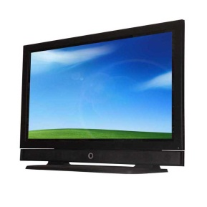
Social & Mass Media
Social Media
An ever increasing force
Over time, sensible voices seem to outweigh (but never replace) extreme views
Mass Media
Most communications go through mass media
Moral responsibility to provide reliable information
Unreliable information can cause unwarranted fear and real harm
Well founded and useful information can improve safety

Slide 14
Issues Identified from the NPP Accident in Japan and Recommendations to Improve the System of Radiological Protection
ICRP Task Group 84
  Chair: Abel J. González (ICRP Vice-chair)
  Established: June 18, 2011
  Summary report released: November 22, 2012
Advice to ICRP, not of ICRP
18 issues identified & several recommendations
Many relate to communications

Slide 15
TG 84: Issues Relating to Communications
Risks of low-dose exposure, particularly internal exposure
Complexities of the system of protection: various units, exposure situations, reference levels, etc.
Protection of children and pregnant women
The meaning of “contamination”

Slide 16
Some Obvious Advice (1)
Communications should
  Restore personal control, confidence, and hope
  Promote responsible action
  Improve safety and general living conditions
Construct a discourse that helps citizens, experts, and authorities to act together to manage the day-to-day situation
Focus on the questions and concerns of stakeholders
Appeal to the responsibility of each actor

Slide 17
Some Obvious Advice (2)
Be open, honest and realistic
  Remain true (scientifically) on the possible actions and their implications
Use plain language
  Avoid expert jargon, euphemisms, and paradoxical injunctions
Provide clear, concise, and practical advice
  Present the facts and what can be done to improve the situation

Slide 18
Some Obvious Advice (3)
Avoid relying too heavily on requirements and prohibitions
Be reassuring when appropriate
Give people the knowledge they need to make their own decisions, and the tools they need to take their own actions
Most people don’t need or want a lesson on radiological protection: they need to know how to work together to improve their situation

Slide 19

www.icrp.org
2nd ICRP Symposium on the International System of Radiological Protection
Abu Dhabi, October 22-24, 2013

